Slide 1
Sliced optimal partial transport
Yikun Bai & Dr. Soheil Kolouri
Vanderbilt University

Slide 2
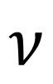
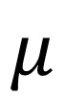
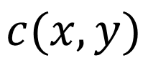
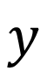
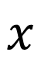
Introduction of Optimal transport
$$c(x,y)$$
$$x$$
$$y$$
$$ν$$
$$μ$$

Slide 3
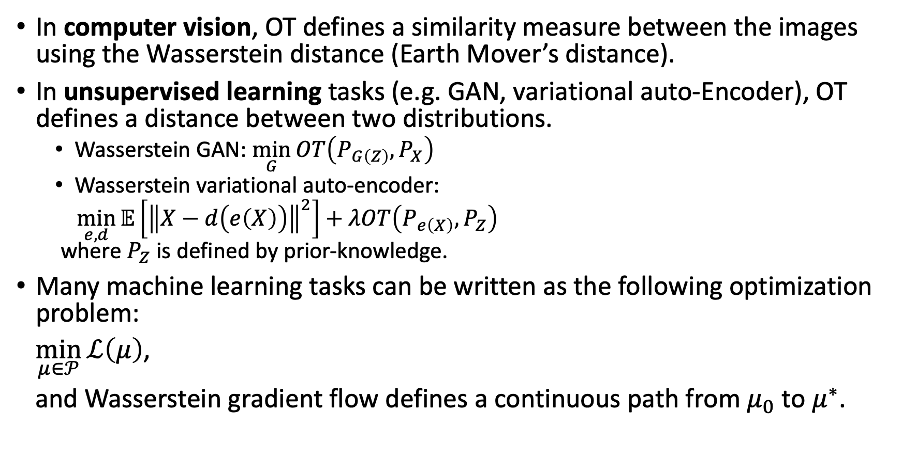
Applications of OT
In computer vision, OT defines a similarity measure between the images using the Wasserstein distance (Earth Mover’s distance).
In unsupervised learning tasks (e.g. GAN, variational auto-Encoder), OT defines a distance between two distributions.
Wasserstein GAN: $\min_{G}{OT\left(P_{G\left(Z\right)},P_{X}\right)}$
Wasserstein variational auto-encoder:
$\min_{e,d}{𝔼\left[{\left\|X−d\left(e\left(X\right)\right)\right\|}^{2}\right]+λOT\left(P_{e\left(X\right)},P_{Z}\right)}$ where $P_{Z}$ is defined by prior-knowledge.
Many machine learning tasks can be written as the following optimization problem:
$\min_{μ∈𝒫}{ℒ\left(μ\right)}$,
and Wasserstein gradient flow defines a continuous path from $μ_{0}$ to $μ^{∗}$.

Slide 4
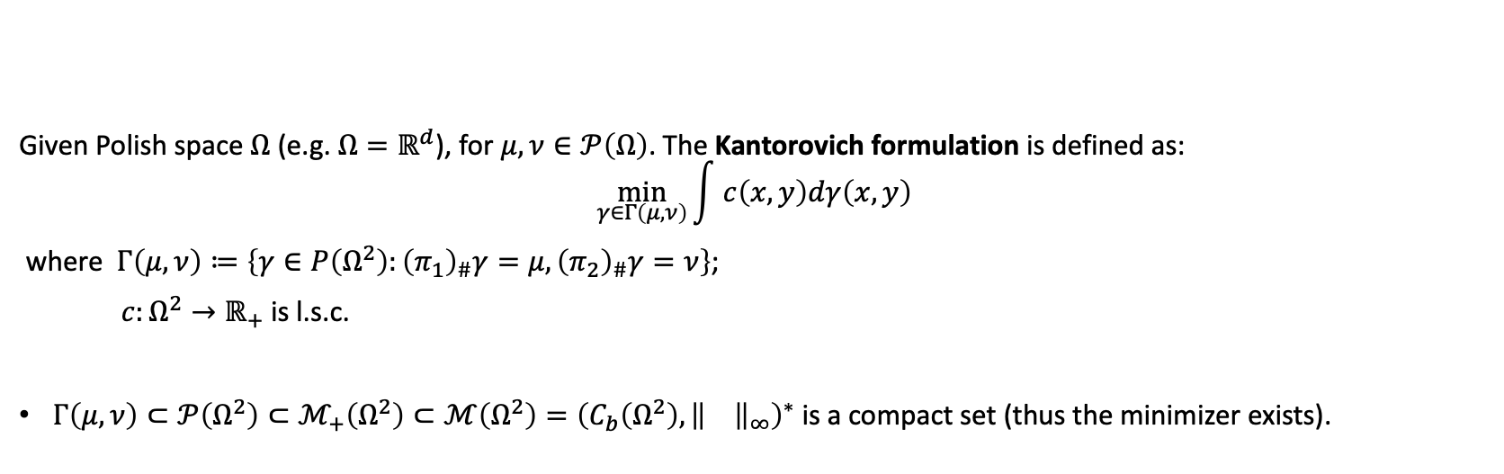
Background: Kantorovich formulation
Given Polish space $Ω$ (e.g. $Ω=ℝ^{d}$), for $μ,ν∈𝒫\left(Ω\right)$. The Kantorovich formulation is defined as: $$\min_{γ∈Γ\left(μ,ν\right)}{\int{ c\left(x,y\right)dγ\left(x,y\right)}}$$
where $Γ\left(μ,ν\right)≔\left\{γ∈P\left(Ω^{2}\right):{\left(π_{1}\right)}_{\#}γ=μ,{\left(π_{2}\right)}_{\#}γ=ν\right\}$;
$c:Ω^{2}→ℝ_{+}$ is l.s.c.
$Γ\left(μ,ν\right)⊂𝒫\left(Ω^{2}\right)⊂ℳ_{+}\left(Ω^{2}\right)⊂ℳ\left(Ω^{2}\right)={\left(C_{b}\left(Ω^{2}\right),{\left\|\right\|}_{∞}\right)}^{∗}$ is a compact set (thus the minimizer exists).

Slide 5
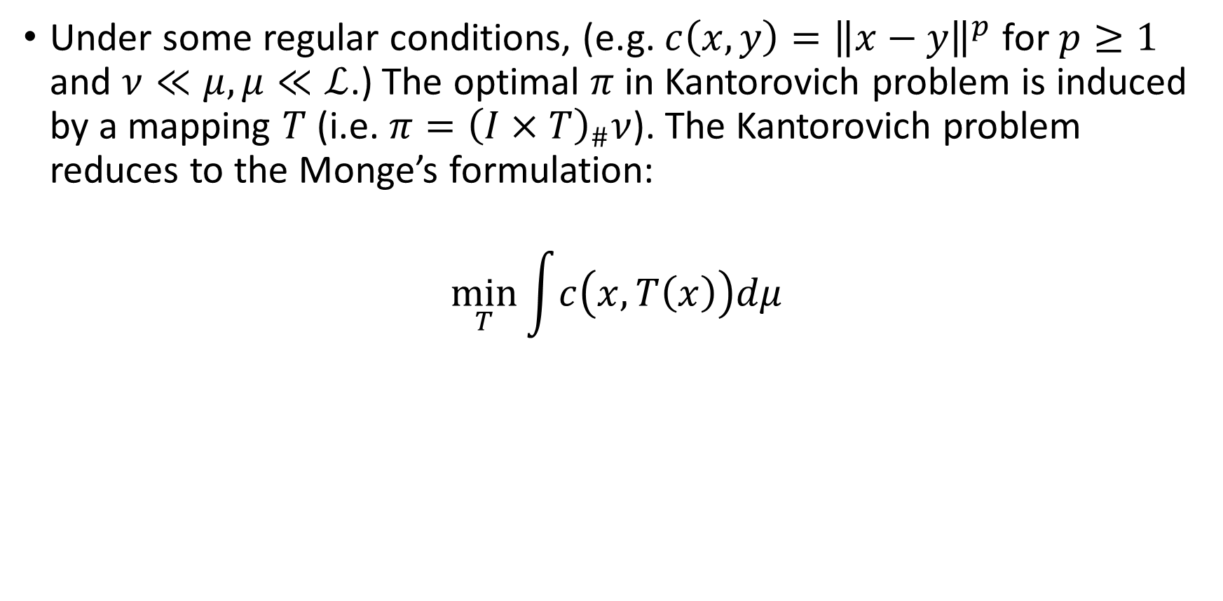
Monge’s formulation
Under some regular conditions, (e.g. $c\left(x,y\right)={\left\|x−y\right\|}^{p}$ for $p≥1$ and $ν≪μ,μ≪ℒ$.) The optimal $π$ in Kantorovich problem is induced by a mapping $T$ (i.e. $π={\left(I×T\right)}_{\#}ν$). The Kantorovich problem reduces to the Monge’s formulation:
$$\min_{T}{\int{c\left(x,T\left(x\right)\right)dμ}}$$

Slide 6
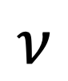
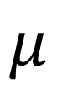
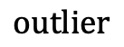
Optimal partial transport (OPT)
$$μ$$
$$outlier$$
outliers
$$ν$$
Motivation: we aim to find a Kantorovich style formulation such that:
It can measure the dissimilarity of two measures who do have different total masses.
E.g. MNIST vs EMNIST
The “outliers” increase the dissimilarity, but their locations does not affect it.

Slide 7
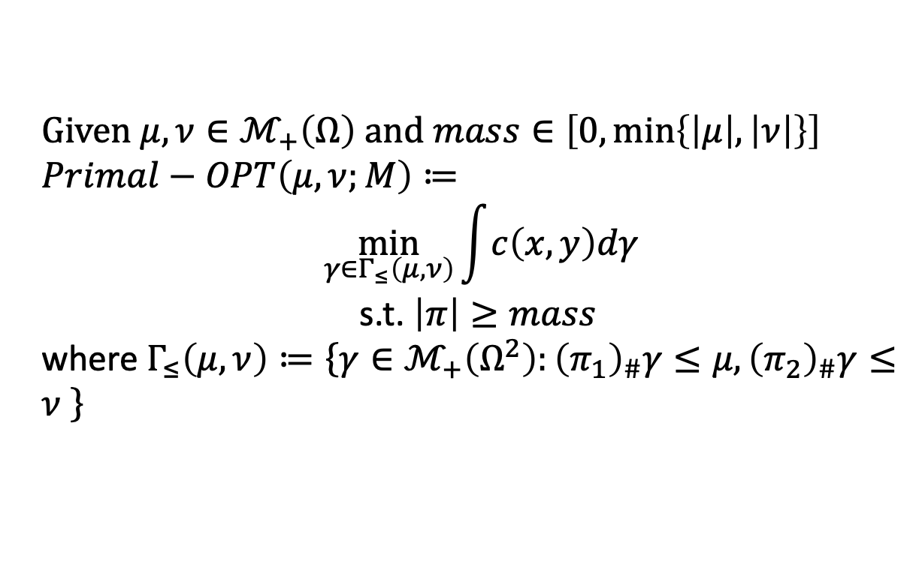
History of formulations of OPT
Primal form of OPT (Caffarelli and McCann, 2010), (Figalli, 2010):
Given $μ,ν∈ℳ_{+}\left(Ω\right)$ and $mass∈\left[0,\min\left\{\left|μ\right|,\left|ν\right|\right\}\right]$
$Primal−OPT\left(μ,ν;M\right)≔$ $$\min_{γ∈Γ_{≤}\left(μ,ν\right)}{\int{c\left(x,y\right)dγ}}$$
s.t. $\left|π\right|≥mass$
where $Γ_{≤}\left(μ,ν\right)≔\left\{γ∈ℳ_{+}\left(Ω^{2}\right):{\left(π_{1}\right)}_{\#}γ≤μ,{\left(π_{2}\right)}_{\#}γ≤ν \right\}$

Slide 8
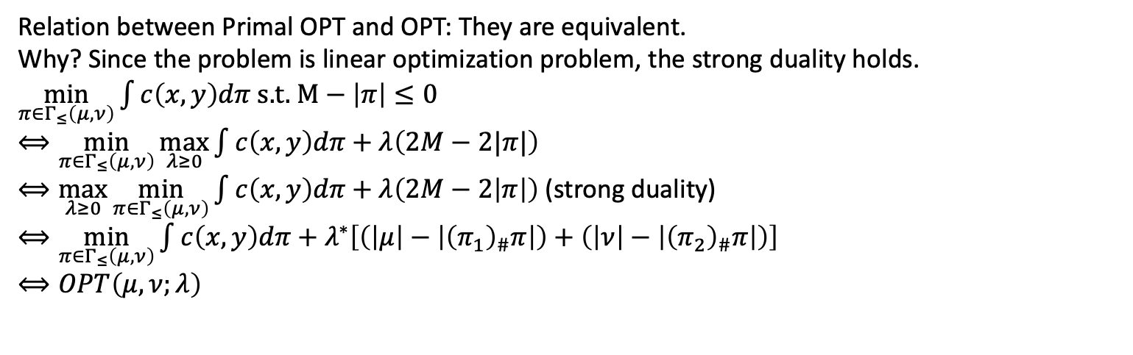
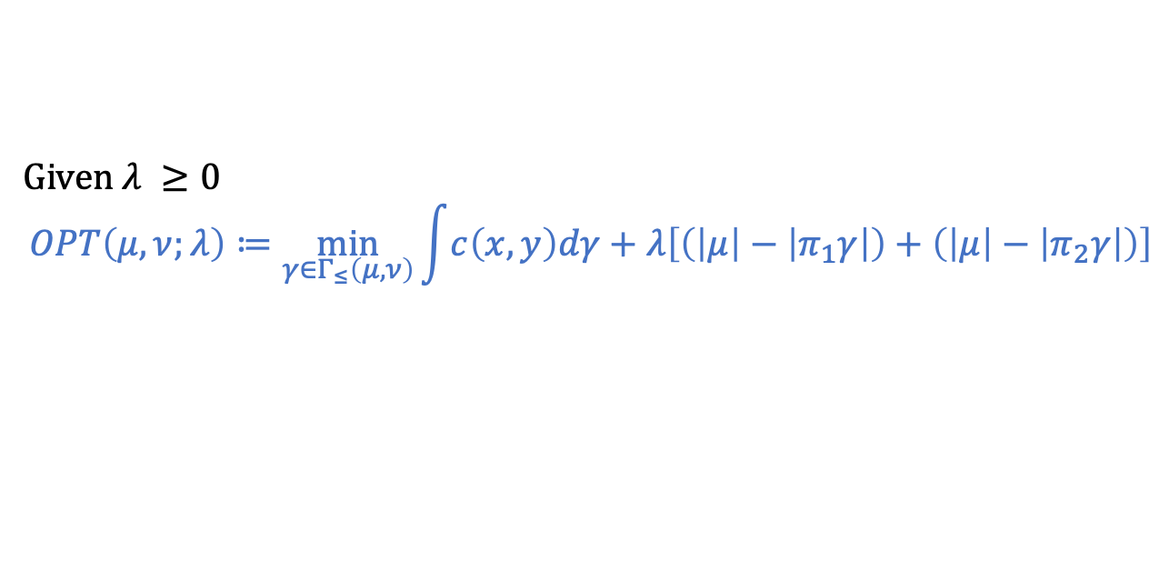
History of formulations of OPT
Given $λ ≥0$
$$OPT\left(μ,ν;λ\right)≔\min_{γ∈Γ_{≤}\left(μ,ν\right)}{\int{c\left(x,y\right)dγ}+λ\left[\left(\left|μ\right|−\left|π_{1}γ\right|\right)+\left(\left|μ\right|−\left|π_{2}γ\right|\right)\right]}$$
Transportation cost
Mass destruction
mass creation
Relation between Primal OPT and OPT: They are equivalent. Why? Since the problem is linear optimization problem, the strong duality holds.
$\min_{π∈Γ_{≤}\left(μ,ν\right)}{\int{c\left(x,y\right)dπ}}$ s.t. $M−\left|π\right|≤0$
$⟺\min_{π∈Γ_{≤}\left(μ,ν\right)}{\max_{λ≥0}{\int{c\left(x,y\right)dπ}+λ\left(2M−2|π|\right)}}$
$⟺\max_{λ≥0}{\min_{π∈Γ_{≤}\left(μ,ν\right)}{\int{c\left(x,y\right)dπ}+λ\left(2M−2\left|π\right|\right)}}$ (strong duality)
$⟺\min_{π∈Γ_{≤}\left(μ,ν\right)}{\int{c\left(x,y\right)dπ}+λ^{∗}\left[\left(\left|μ\right|−\left|{\left(π_{1}\right)}_{\#}π\right|\right)+\left(\left|ν\right|−\left|{\left(π_{2}\right)}_{\#}π\right|\right)\right]}$
$⟺OPT\left(μ,ν;λ\right)$

Slide 9
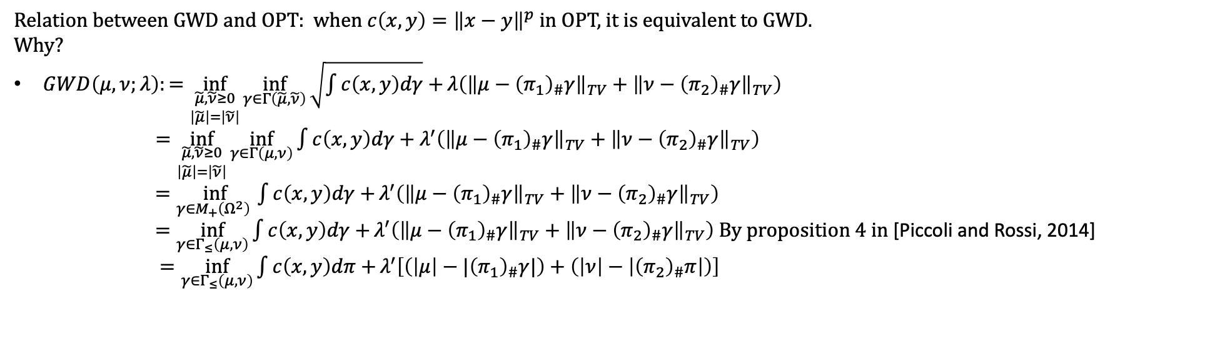
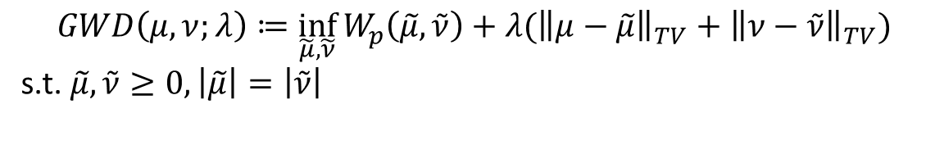
History of formulations of OPT
Generalized Wasserstein Distance [Piccoli and Rossi, 2014]:
$$GWD\left(μ,ν;λ\right)≔\inf_{\tilde{μ},\tilde{ν}}{W_{p}\left(\tilde{μ},\tilde{ν}\right)+λ({\left\|μ−\tilde{μ}\right\|}_{TV}+{\left\|ν−\tilde{ν}\right\|}_{TV}})$$
s.t. $\tilde{μ},\tilde{ν}≥0,\left|\tilde{μ}\right|=\left|\tilde{ν}\right|$
Relation between GWD and OPT: when $c\left(x,y\right)={\left\|x−y\right\|}^{p}$ in OPT, it is equivalent to GWD. Why?
$GWD\left(μ,ν;λ\right):=\inf_{\begin{aligned}\tilde{μ},\tilde{ν}≥0 \\ \left|\tilde{μ}\right|=\left|\tilde{ν}\right|\end{aligned}}{\inf_{γ∈Γ\left(\tilde{μ},\tilde{ν}\right)}{\sqrt{\int{c\left(x,y\right)dγ}}+}λ\left({\left\|μ−{\left(π_{1}\right)}_{\#}γ\right\|}_{TV}+{\left\|ν−{\left(π_{2}\right)}_{\#}γ\right\|}_{TV}\right)}$
$=\inf_{\begin{aligned}\tilde{μ},\tilde{ν}≥0 \\ \left|\tilde{μ}\right|=\left|\tilde{ν}\right|\end{aligned}}{\inf_{γ∈Γ\left(μ,ν\right)}{\int{c\left(x,y\right)dγ}}+λ^{′}\left({\left\|μ−{\left(π_{1}\right)}_{\#}γ\right\|}_{TV}+{\left\|ν−{\left(π_{2}\right)}_{\#}γ\right\|}_{TV}\right)}$
$=\inf_{γ∈M_{+}\left(Ω^{2}\right) }{\int{c\left(x,y\right)dγ}+}λ^{′}\left({\left\|μ−{\left(π_{1}\right)}_{\#}γ\right\|}_{TV}+{\left\|ν−{\left(π_{2}\right)}_{\#}γ\right\|}_{TV}\right)$
$=\inf_{γ∈Γ_{≤}\left(μ,ν\right)}{\int{c\left(x,y\right)dγ}+}λ^{′}\left({\left\|μ−{\left(π_{1}\right)}_{\#}γ\right\|}_{TV}+{\left\|ν−{\left(π_{2}\right)}_{\#}γ\right\|}_{TV}\right)$ By proposition 4 in [Piccoli and Rossi, 2014]
$=\inf_{γ∈Γ_{≤}\left(μ,ν\right)}{\int{c\left(x,y\right)dπ}+}λ^{′}\left[\left(\left|μ\right|−{|\left(π_{1}\right)}_{\#}γ|\right)+\left(\left|ν\right|−\left|{\left(π_{2}\right)}_{\#}π\right|\right)\right]$

Slide 10
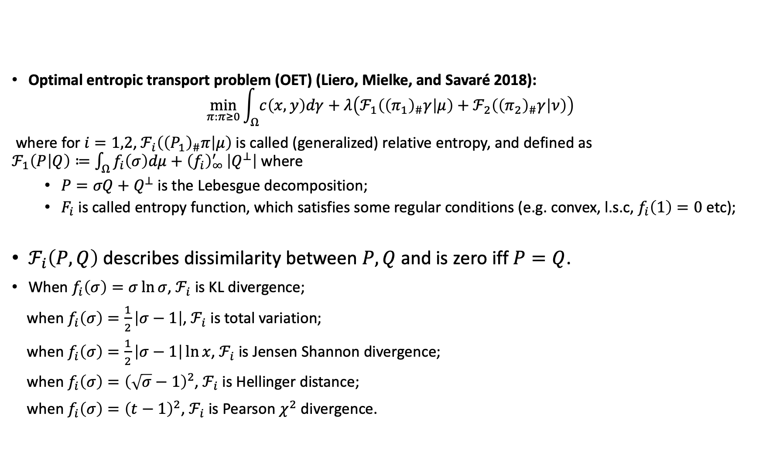
Generalization of OPT: Unbalanced OT
Optimal entropic transport problem (OET) (Liero, Mielke, and Savaré 2018):
$$\min_{π:π≥0}{\int_{Ω}{c\left(x,y\right)dγ}+λ\left(ℱ_{1}\left({\left(π_{1}\right)}_{\#}γ | μ\right)+ℱ_{2}\left({\left(π_{2}\right)}_{\#}γ | ν\right)\right)}$$
where for $i=1,2$, $ℱ_{i}\left({\left(P_{1}\right)}_{\#}π | μ\right)$ is called (generalized) relative entropy, and defined as $ℱ_{1}\left(P | Q\right)≔\int_{Ω}{f_{i}\left(σ\right)dμ+{\left(f_{i}\right)}_{∞}^{′}}\left|Q^{⊥}\right|$ where
$P=σQ+Q^{⊥}$ is the Lebesgue decomposition;
$F_{i}$ is called entropy function, which satisfies some regular conditions (e.g. convex, l.s.c, $f_{i}\left(1\right)=0$ etc);
$ℱ_{i}\left(P,Q\right)$ describes dissimilarity between $P,Q$ and is zero iff $P=Q$.
When $f_{i}\left(σ\right)=σ\ln{σ}$, $ℱ_{i}$ is KL divergence;
when $f_{i}\left(σ\right)=\frac{1}{2}\left|σ−1\right|$, $ℱ_{i}$ is total variation;
when $f_{i}\left(σ\right)=\frac{1}{2}\left|σ−1\right|\ln{x}$, $ℱ_{i}$ is Jensen Shannon divergence;
when $f_{i}\left(σ\right)={\left(\sqrt{σ}−1\right)}^{2}$, $ℱ_{i}$ is Hellinger distance;
when $f_{i}\left(σ\right)={\left(t−1\right)}^{2}$, $ℱ_{i}$ is Pearson $χ^{2}$ divergence.

Slide 11
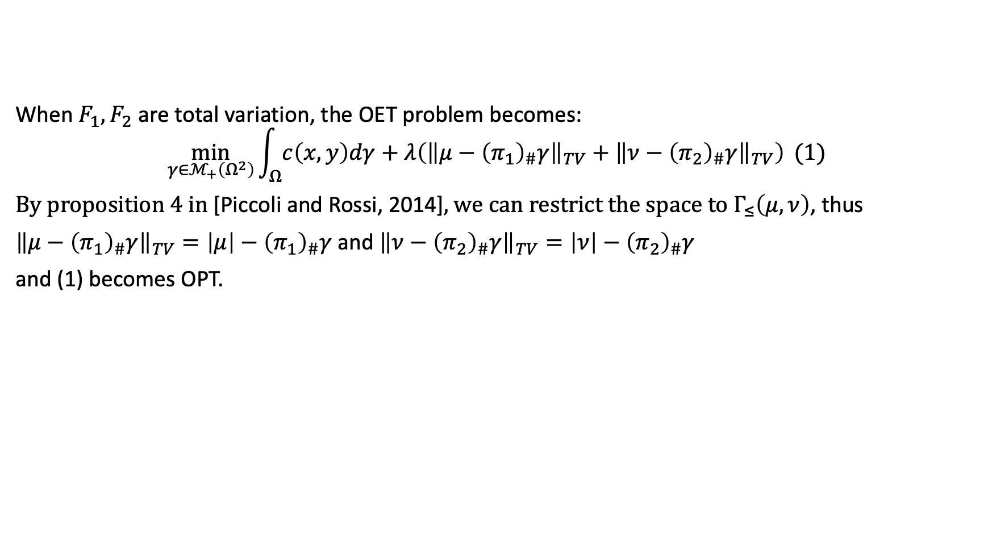
Relation between OET and OPT
When $F_{1},F_{2}$ are total variation, the OET problem becomes:
$$\min_{γ∈ℳ_{+}\left(Ω^{2}\right)}{\int_{Ω}{c\left(x,y\right)dγ}+λ\left({\left\|μ−{\left(π_{1}\right)}_{\#}γ\right\|}_{TV}+{\left\|ν−{\left(π_{2}\right)}_{\#}γ\right\|}_{TV}\right)} (1)$$
By proposition 4 in [Piccoli and Rossi, 2014], we can restrict the space to $Γ_{≤}\left(μ,ν\right)$, thus
${\left\|μ−{\left(π_{1}\right)}_{\#}γ\right\|}_{TV}=\left|μ\right|−{\left(π_{1}\right)}_{\#}γ$ and ${\left\|ν−{\left(π_{2}\right)}_{\#}γ\right\|}_{TV}=\left|ν\right|−{\left(π_{2}\right)}_{\#}γ$
and (1) becomes OPT.

Slide 12
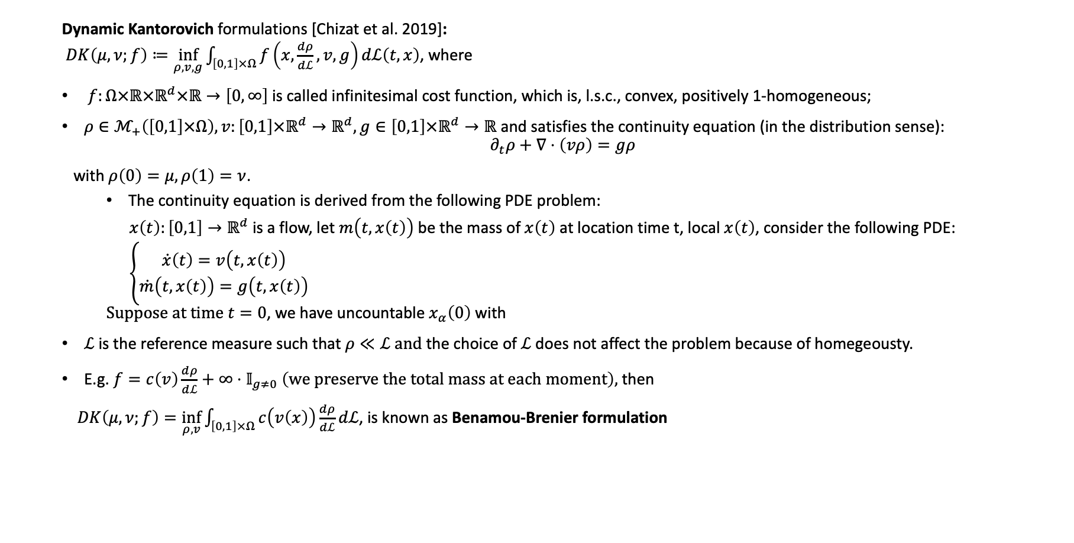
Generalization of OPT: Unbalanced OT
Dynamic Kantorovich formulations [Chizat et al. 2019]: $DK\left(μ,ν;f\right)≔\inf_{ρ,v,g}{\int_{\left[0,1\right]×Ω}{f\left(x,\frac{dρ}{dℒ},v,g\right)dℒ\left(t,x\right)}}$, where
$f:Ω×ℝ×ℝ^{d}×ℝ→\left[0,∞\right]$ is called infinitesimal cost function, which is, l.s.c., convex, positively 1-homogeneous;
$ρ∈ℳ_{+}\left(\left[0,1\right]×Ω\right),v:\left[0,1\right]×ℝ^{d}→ℝ^{d},g∈\left[0,1\right]×ℝ^{d}→ℝ$ and satisfies the continuity equation (in the distribution sense):
$$∂_{t}ρ+∇⋅\left(vρ\right)=gρ$$
with $ρ\left(0\right)=μ,ρ\left(1\right)=ν$.
The continuity equation is derived from the following PDE problem:
$x\left(t\right):\left[0,1\right]→ℝ^{d}$ is a flow, let $m\left(t,x\left(t\right)\right)$ be the mass of $x\left(t\right)$ at location time t, local $x\left(t\right)$, consider the following PDE:
$\left\{\begin{aligned}\dot{x}\left(t\right)=v\left(t,x\left(t\right)\right) \\ \dot{m}\left(t,x\left(t\right)\right)=g\left(t,x\left(t\right)\right)\end{aligned}\right.$ Suppose at time $t=0$, we have uncountable $x_{α}\left(0\right)$ with
$ℒ$ is the reference measure such that $ρ≪ℒ and$the choice of $ℒ$ does not affect the problem because of homegeousty.
E.g. $f=c\left(v\right)\frac{dρ}{dℒ}+∞⋅𝕀_{g≠0} \left(we preserve the total mass at each moment\right),$then
$DK\left(μ, ν;f\right)=\inf_{ρ,v}\int_{\left[0,1\right]×Ω}{c\left(v\left(x\right)\right)\frac{dρ}{dℒ}}dℒ$, is known as Benamou-Brenier formulation

Slide 13
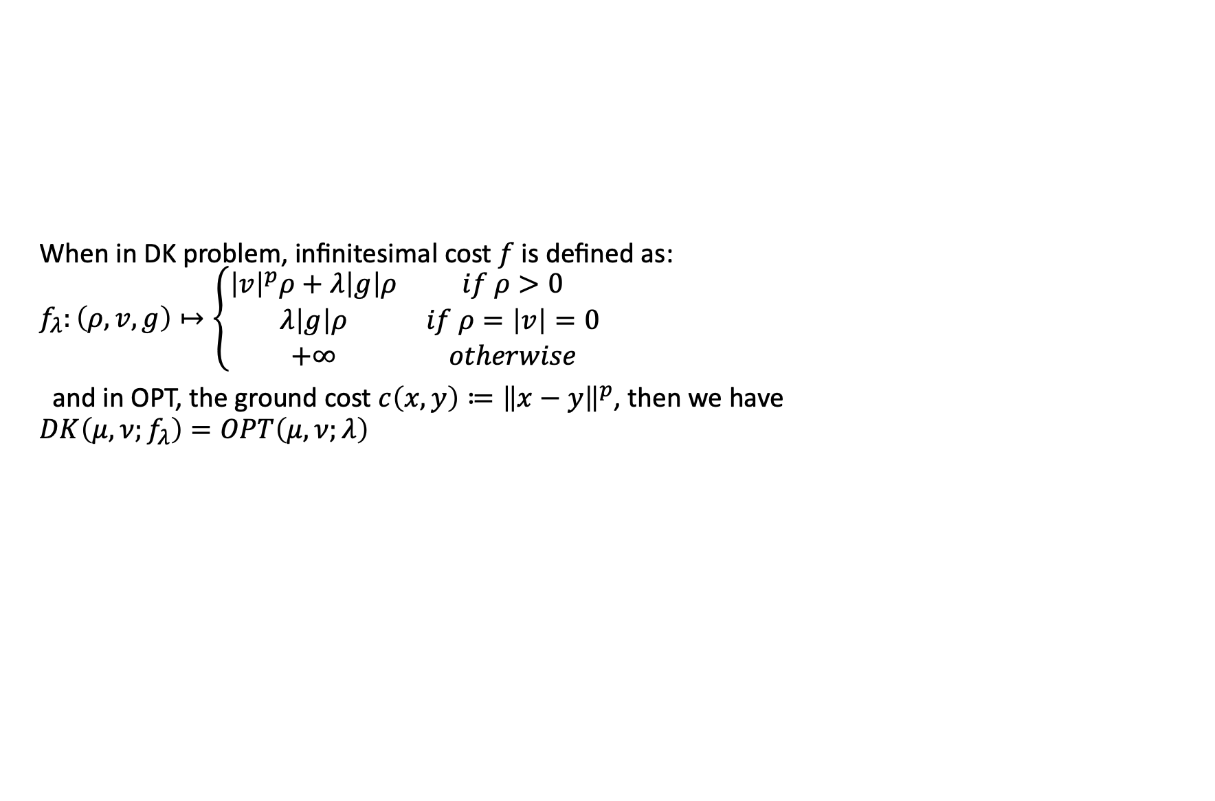
Relation between DK and OPT
When in DK problem, infinitesimal cost $f$ is defined as: $f_{λ}:\left(ρ,v,g\right)↦\left\{\begin{matrix}{\left|v\right|}^{p}ρ+λ\left|g\right|ρ & if ρ>0 \\ λ\left|g\right|ρ & if ρ=\left|v\right|=0 \\ +∞ & otherwise\end{matrix}\right.$
and in OPT, the ground cost $c\left(x,y\right)≔{\left\|x−y\right\|}^{p}$, then we have $DK\left(μ,ν;f_{λ}\right)=OPT\left(μ,ν;λ\right)$

Slide 14
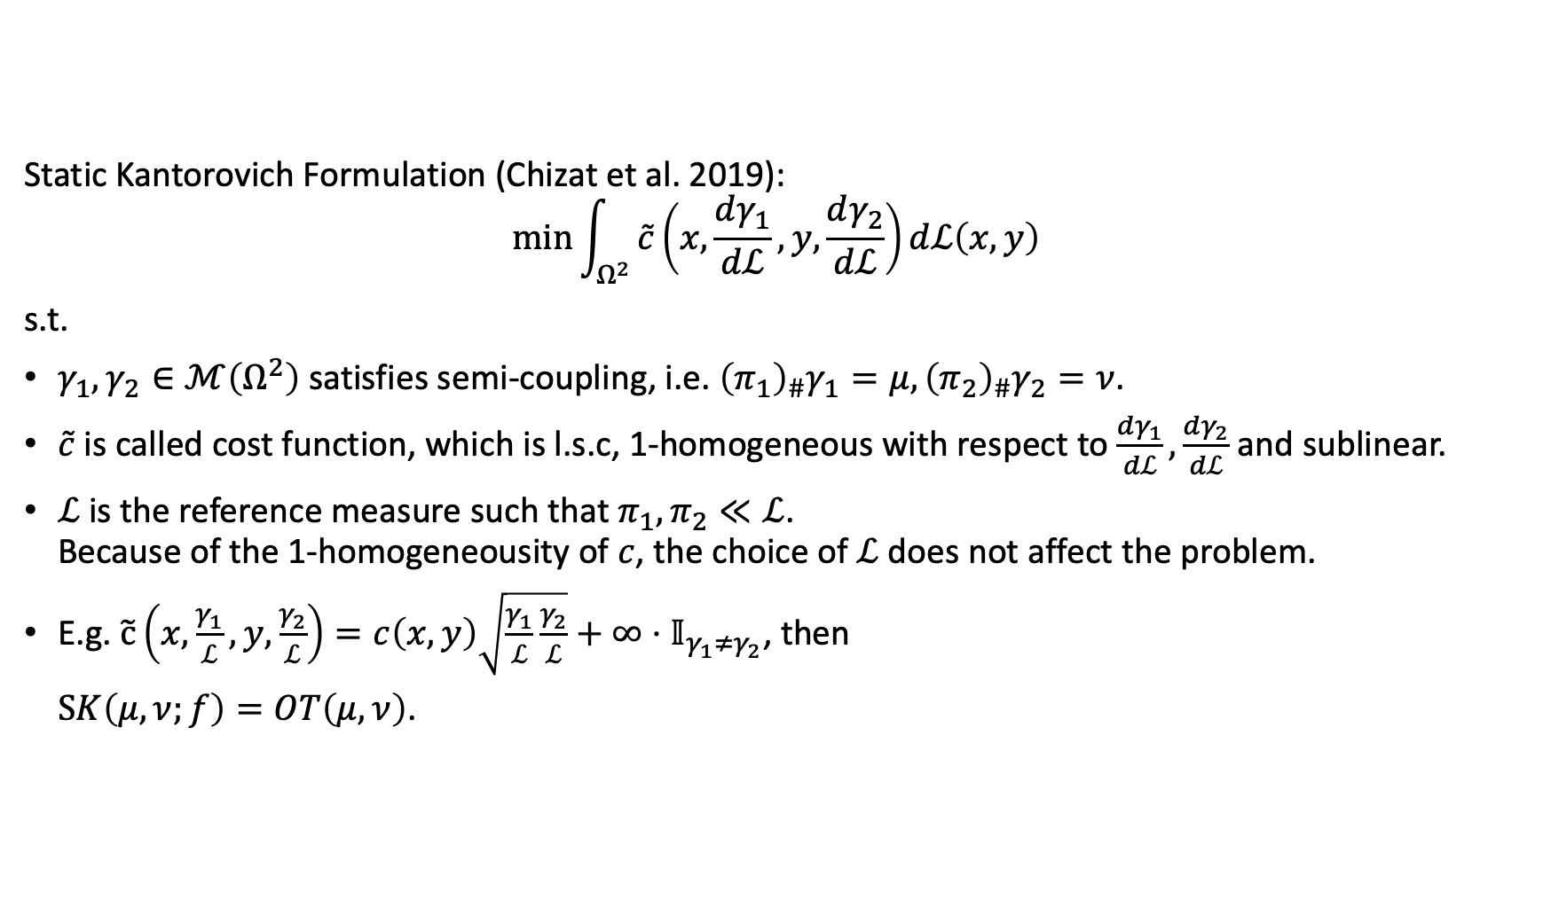
Generalization of OPT: Unbalanced OT
Static Kantorovich Formulation (Chizat et al. 2019):
$$\min{\int_{Ω^{2}}{\tilde{c}\left(x,\frac{dγ_{1}}{dℒ},y,\frac{dγ_{2}}{dℒ}\right)dℒ\left(x,y\right)}}$$
s.t.
$γ_{1},γ_{2}∈ℳ\left(Ω^{2}\right)$ satisfies semi-coupling, i.e. ${\left(π_{1}\right)}_{\#}γ_{1}=μ,{\left(π_{2}\right)}_{\#}γ_{2}=ν$.
$\tilde{c}$ is called cost function, which is l.s.c, 1-homogeneous with respect to $\frac{dγ_{1}}{dℒ},\frac{dγ_{2}}{dℒ}$ and sublinear.
$ℒ$ is the reference measure such that $π_{1},π_{2}≪ℒ$. Because of the 1-homogeneousity of $c$, the choice of $ℒ$ does not affect the problem.
E.g. $\tilde{c}\left(x,\frac{γ_{1}}{ℒ},y,\frac{γ_{2}}{ℒ}\right)=c\left(x,y\right)\sqrt{\frac{γ_{1}}{ℒ}\frac{γ_{2}}{ℒ}}+∞⋅𝕀_{γ_{1}≠γ_{2}}$, then
$SK\left(μ, ν;f\right)=OT\left(μ,ν\right)$.

Slide 15
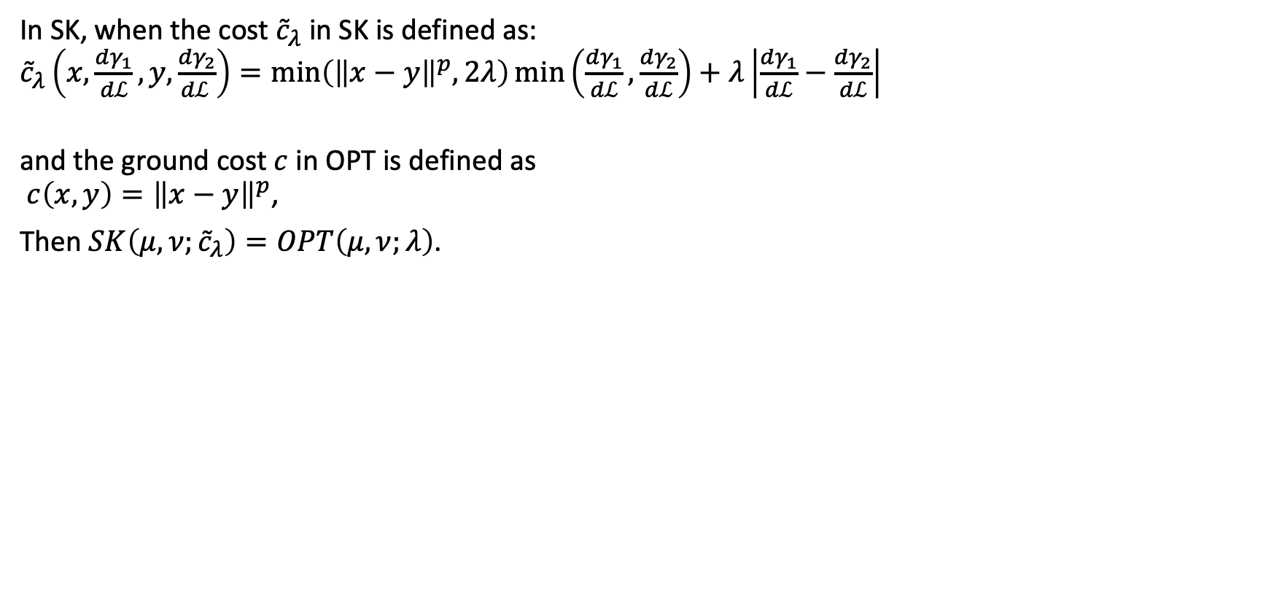
Relation between SK and OPT
In SK, when the cost ${\tilde{c}}_{λ}$ in SK is defined as: ${\tilde{c}}_{λ}\left(x,\frac{dγ_{1}}{dℒ},y,\frac{dγ_{2}}{dℒ }\right)=\min\left({\left\|x−y\right\|}^{p},2λ\right)\min\left(\frac{dγ_{1}}{dℒ},\frac{dγ_{2}}{dℒ}\right)+λ\left|\frac{dγ_{1}}{dℒ}−\frac{dγ_{2}}{dℒ}\right|$
and the ground cost $c$ in OPT is defined as $c\left(x,y\right)={\left\|x−y\right\|}^{p}$,
Then $SK\left(μ,ν;{\tilde{c}}_{λ}\right)=OPT\left(μ,ν;λ\right)$.

Slide 16
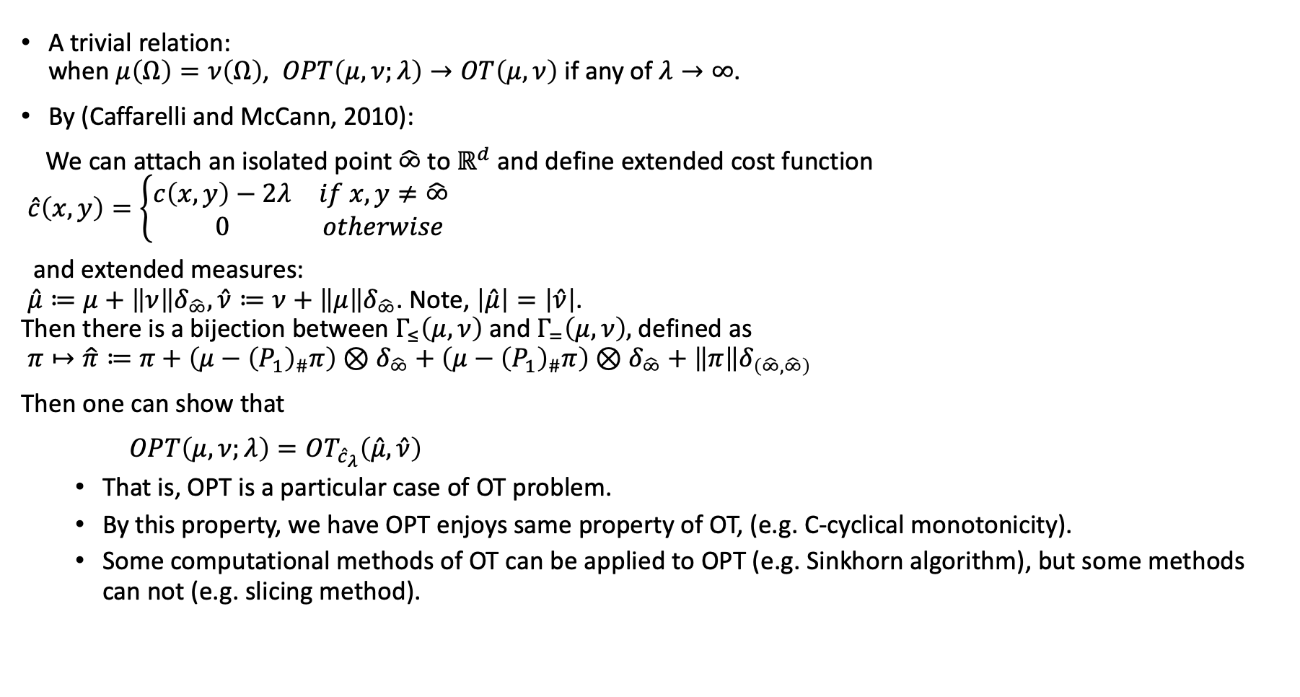
Relation of OT and OPT
A trivial relation: when $μ\left(Ω\right)=ν\left(Ω\right)$, $OPT\left(μ,ν;λ\right)→OT\left(μ,ν\right)$ if any of $λ→∞$.
By (Caffarelli and McCann, 2010):
We can attach an isolated point $\hat{∞}$ to $ℝ^{d}$ and define extended cost function $\hat{c}\left(x,y\right)=\left\{\begin{matrix}c\left(x,y\right)−2λ & if x,y≠\hat{∞} \\ 0 & otherwise\end{matrix}\right.$
and extended measures: $\hat{μ}≔μ+\left\|ν\right\|δ_{\hat{∞}},\hat{ν}≔ν+\left\|μ\right\|δ_{\hat{∞}}$. Note, $\left|\hat{μ}\right|=\left|\hat{ν}\right|$. Then there is a bijection between $Γ_{≤}\left(μ,ν\right)$ and $Γ_{=}\left(μ,ν\right),$defined as $π↦\hat{π}≔π+\left(μ−{\left(P_{1}\right)}_{\#}π\right)⊗δ_{\hat{∞}}+\left(μ−{\left(P_{1}\right)}_{\#}π\right)⊗δ_{\hat{∞}}+\left\|π\right\|δ_{\left(\hat{∞},\hat{∞}\right)}$
Then one can show that
$OPT\left(μ,ν;λ\right)=OT_{{\hat{c}}_{λ}}\left(\hat{μ},\hat{ν}\right)$
That is, OPT is a particular case of OT problem.
By this property, we have OPT enjoys same property of OT, (e.g. C-cyclical monotonicity).
Some computational methods of OT can be applied to OPT (e.g. Sinkhorn algorithm), but some methods can not (e.g. slicing method).

Slide 17


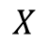
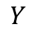
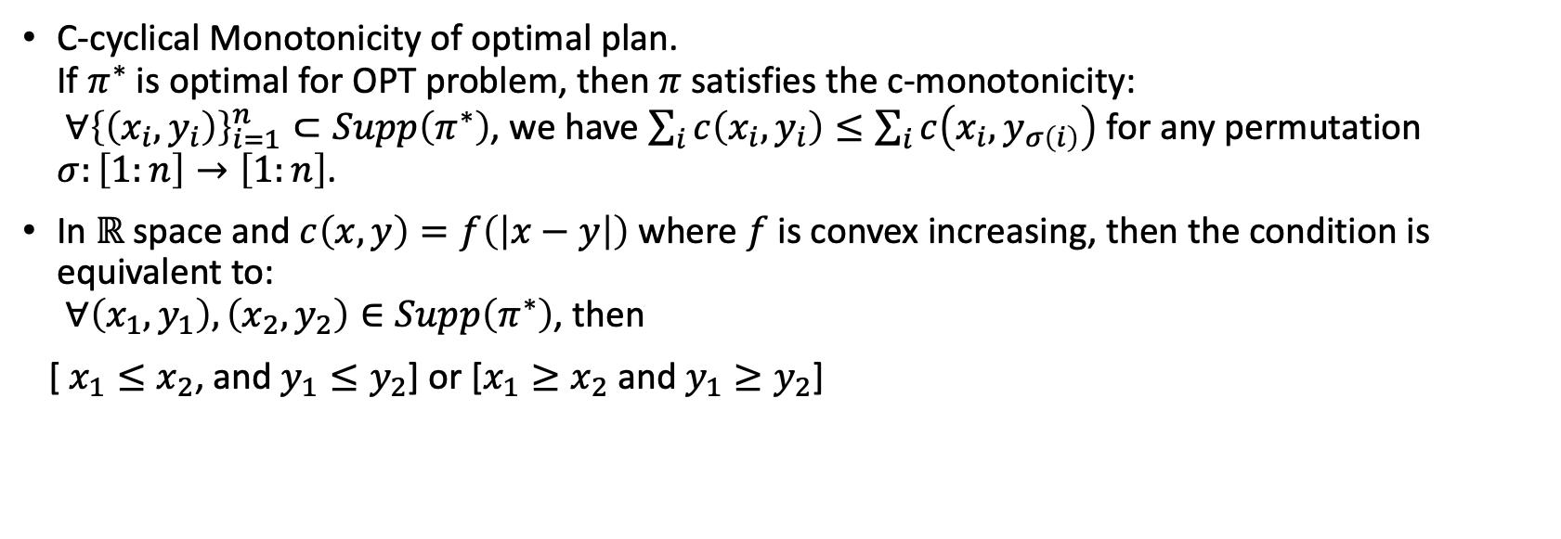
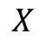
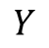
Basic properties of OPT
C-cyclical Monotonicity of optimal plan. If $π^{∗}$ is optimal for OPT problem, then $π$ satisfies the c-monotonicity: $∀{\left\{\left(x_{i},y_{i}\right)\right\}}_{i=1}^{n}⊂Supp\left(π^{∗}\right)$, we have $\sum_{i}{c\left(x_{i},y_{i}\right)}≤\sum_{i}{c\left(x_{i},y_{σ\left(i\right)}\right)}$ for any permutation $σ:\left[1:n\right]→\left[1:n\right]$.
In $ℝ$ space and $c\left(x,y\right)=f\left(\left|x−y\right|\right)$ where $f$ is convex increasing, then the condition is equivalent to: $∀\left(x_{1},y_{1}\right),\left(x_{2},y_{2}\right)∈Supp\left(π^{∗}\right)$, then
[ $x_{1}≤x_{2}$, and $y_{1}≤y_{2}$] or [$x_{1}≥x_{2}$ and $y_{1}≥y_{2}$]
$$X$$
$$X$$
$$Y$$
$$Y$$

Slide 18
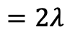
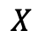
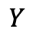
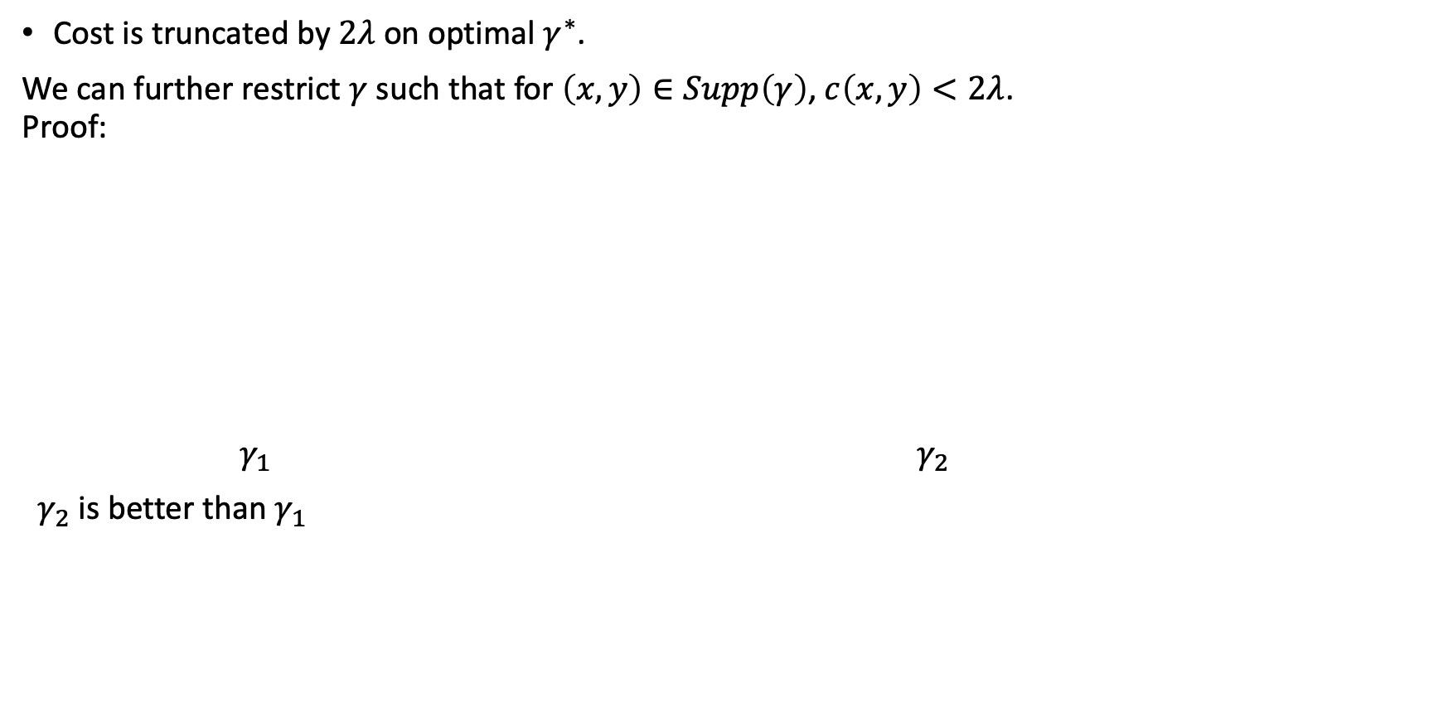
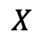
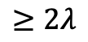
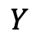
Basic properties of OPT
Cost is truncated by $2λ$ on optimal $γ^{∗}$.
We can further restrict $γ$ such that for $\left(x,y\right)∈Supp\left(γ\right)$, $c\left(x,y\right)<2λ$. Proof:
$γ_{1}$ $γ_{2}$
$γ_{2}$ is better than $γ_{1}$
$$X$$
$$X$$
$$≥2λ$$
$$=2λ$$
$$Y$$
$$Y$$

Slide 19
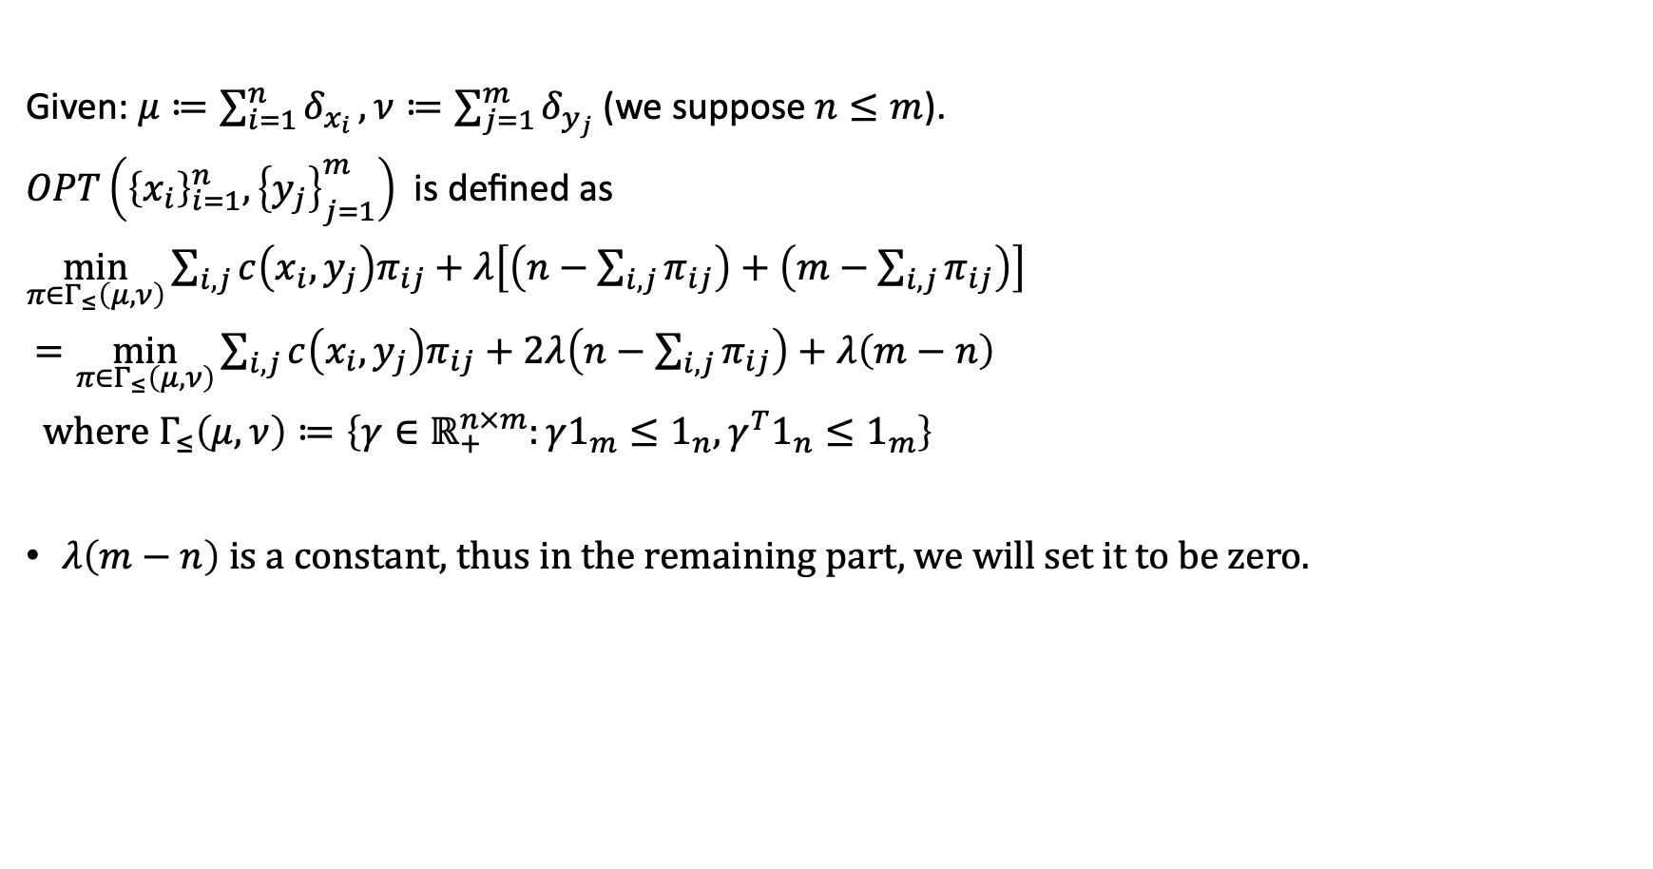
Empirical OPT
Given: $μ≔\sum_{i=1}^{n}{δ_{x_{i}}},ν≔\sum_{j=1}^{m}{δ_{y_{j}}}$ (we suppose $n≤m$).
$OPT\left({\left\{x_{i}\right\}}_{i=1}^{n},{\left\{y_{j}\right\}}_{j=1}^{m}\right)$ is defined as
$\min_{π∈Γ_{≤}\left(μ,ν\right)}{\sum_{i,j}{c\left(x_{i},y_{j}\right)π_{ij}}+λ\left[\left(n−\sum_{i,j}{π_{ij}}\right)+\left(m−\sum_{i,j}{π_{ij}}\right)\right]}$
$=\min_{π∈Γ_{≤}\left(μ,ν\right)}{\sum_{i,j}{c\left(x_{i},y_{j}\right)π_{ij}}+2λ\left(n−\sum_{i,j}{π_{ij}}\right)+λ\left(m−n\right)}$
where $Γ_{≤}\left(μ,ν\right)≔\left\{γ∈ℝ_{+}^{n×m}:γ1_{m}≤1_{n},γ^{T}1_{n}≤1_{m}\right\}$
$λ\left(m−n\right)$ is a constant, thus in the remaining part, we will set it to be zero.

Slide 20
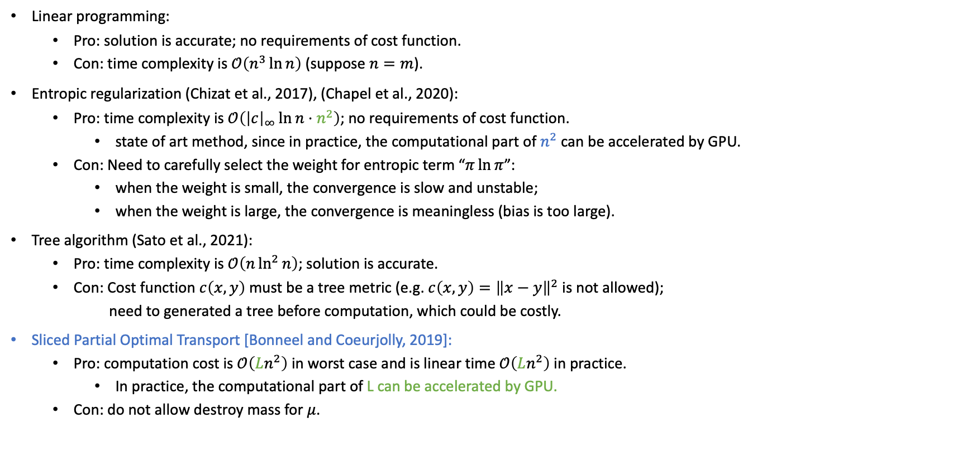
Computation of Empirical OPT
Linear programming:
Pro: solution is accurate; no requirements of cost function.
Con: time complexity is $𝒪\left(n^{3}\ln{n}\right)$ (suppose $n=m$).
Entropic regularization (Chizat et al., 2017), (Chapel et al., 2020):
Pro: time complexity is $𝒪\left({\left|c\right|}_{∞}\ln{n}⋅n^{2}\right)$; no requirements of cost function.
state of art method, since in practice, the computational part of $n^{2}$ can be accelerated by GPU.
Con: Need to carefully select the weight for entropic term “$π\ln{π}$”:
when the weight is small, the convergence is slow and unstable;
when the weight is large, the convergence is meaningless (bias is too large).
Tree algorithm (Sato et al., 2021):
Pro: time complexity is $𝒪\left(n\ln^{2}{n}\right)$; solution is accurate.
Con: Cost function $c\left(x,y\right)$ must be a tree metric (e.g. $c\left(x,y\right)={\left\|x−y\right\|}^{2}$ is not allowed);
need to generated a tree before computation, which could be costly.
Sliced Partial Optimal Transport [Bonneel and Coeurjolly, 2019]:
Pro: computation cost is $𝒪\left(Ln^{2}\right)$ in worst case and is linear time $𝒪\left(Ln^{2}\right)$ in practice.
In practice, the computational part of L can be accelerated by GPU.
Con: do not allow destroy mass for $μ$.

Slide 21
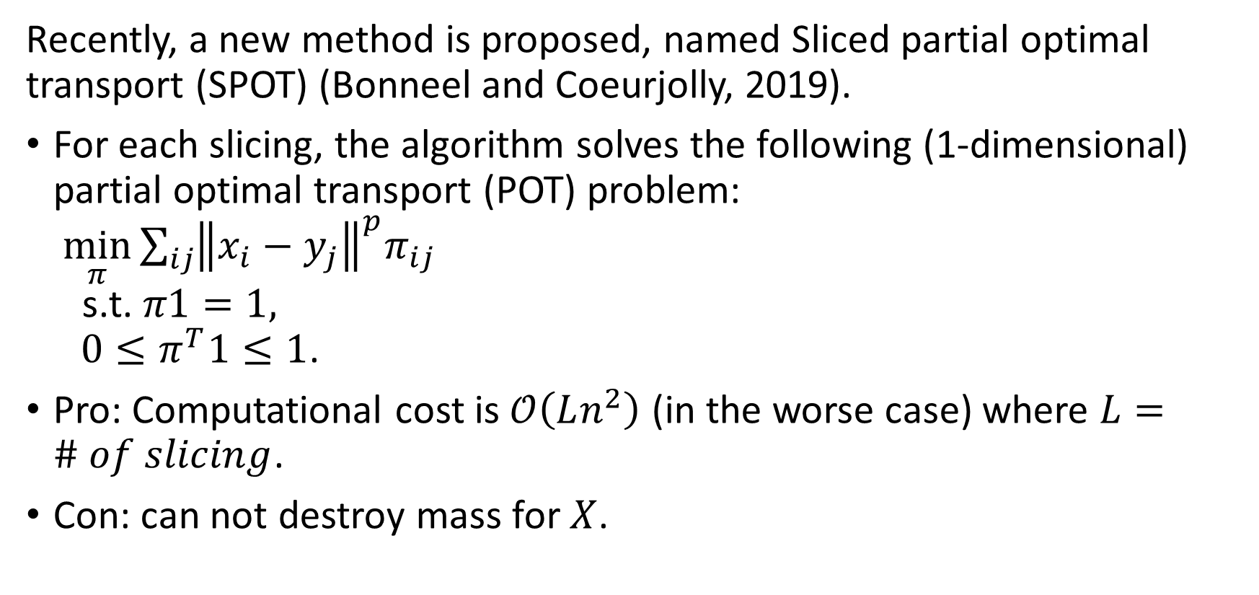
Sliced Partial Optimal Transport
Recently, a new method is proposed, named Sliced partial optimal transport (SPOT) (Bonneel and Coeurjolly, 2019).
For each slicing, the algorithm solves the following (1-dimensional) partial optimal transport (POT) problem: $\min_{π}{\sum_{ij}{{\left\|x_{i}−y_{j}\right\|}^{p}π_{ij}}}$ s.t. $π1=1,$ $0≤π^{T}1≤1$.
Pro: Computational cost is $𝒪\left(Ln^{2}\right)$ (in the worse case) where $L=\# of slicing$.
Con: can not destroy mass for $X$.

Slide 22
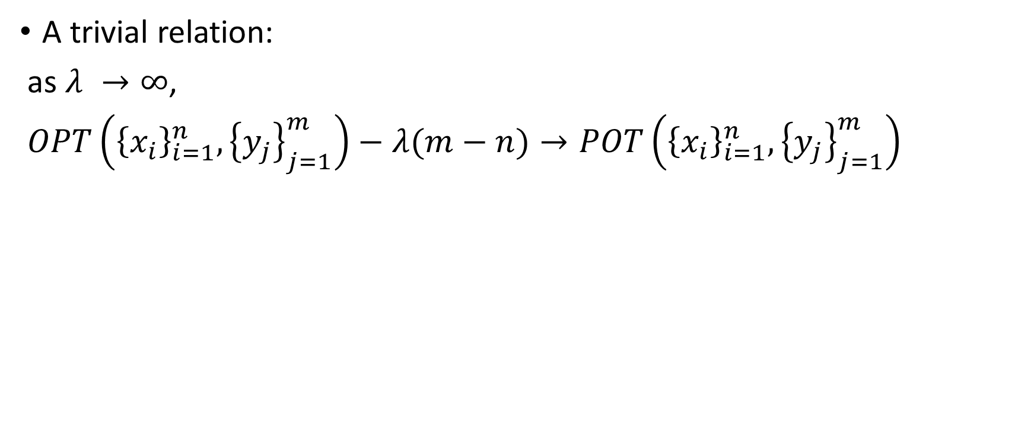
Relation between OPT and POT
A trivial relation:
as $λ →∞$,
$OPT\left({\left\{x_{i}\right\}}_{i=1}^{n},{\left\{y_{j}\right\}}_{j=1}^{m}\right)−λ(m−n)→POT\left({\left\{x_{i}\right\}}_{i=1}^{n},{\left\{y_{j}\right\}}_{j=1}^{m}\right)$

Slide 23
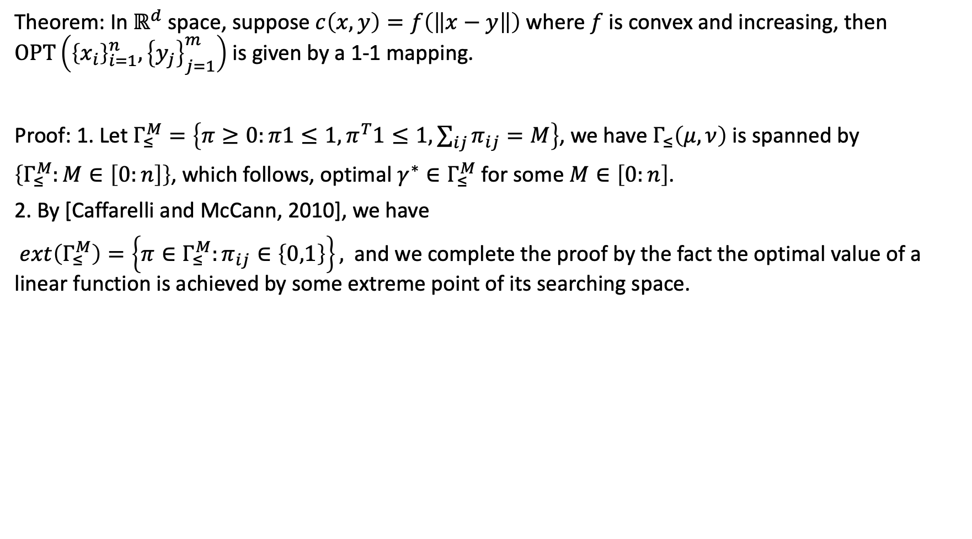
Theoretical result of empirical OPT
Theorem: In $ℝ^{d}$ space, suppose $c\left(x,y\right)=f\left(\left\|x−y\right\|\right)$ where $f$ is convex and increasing, then $OPT\left({\left\{x_{i}\right\}}_{i=1}^{n},{\left\{y_{j}\right\}}_{j=1}^{m}\right)$ is given by a 1-1 mapping.
Proof: 1. Let $Γ_{≤}^{M}=\left\{π≥0:π1≤1,π^{T}1≤1,\sum_{ij}{π_{ij}}=M\right\}$, we have $Γ_{≤}\left(μ,ν\right)$ is spanned by
$\left\{Γ_{≤}^{M}:M∈\left[0:n\right]\right\}$, which follows, optimal $γ^{∗}∈Γ_{≤}^{M}$ for some $M∈\left[0:n\right]$.
2. By [Caffarelli and McCann, 2010], we have
$ext\left(Γ_{≤}^{M}\right)=\left\{π∈Γ_{≤}^{M}:π_{ij}∈\left\{0,1\right\}\right\},$ and we complete the proof by the fact the optimal value of a linear function is achieved by some extreme point of its searching space.

Slide 24
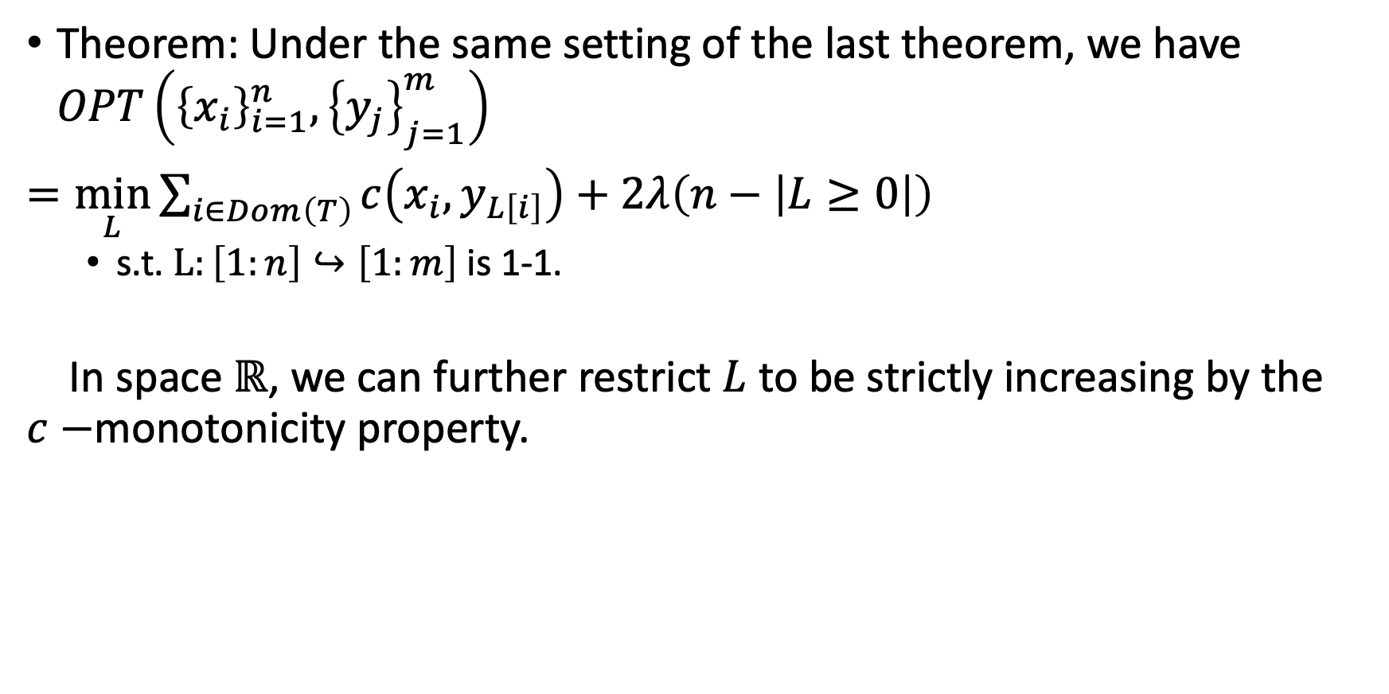
Theoretical result of empirical OPT
Theorem: Under the same setting of the last theorem, we have $OPT\left({\left\{x_{i}\right\}}_{i=1}^{n},{\left\{y_{j}\right\}}_{j=1}^{m}\right)$
$=\min_{L}{\sum_{i∈Dom\left(T\right)}{c\left(x_{i},y_{L\left[i\right]}\right)}+2λ\left(n−\left|L≥0\right|\right)}$
s.t. $L:\left[1:n\right]↪\left[1:m\right]$ is 1-1.
In space $ℝ$, we can further restrict $L$ to be strictly increasing by the $c−$monotonicity property.

Slide 25
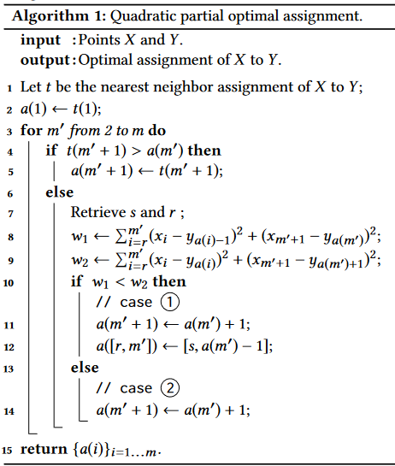
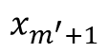
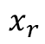
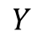
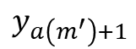
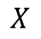
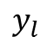
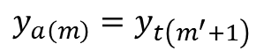
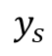
















Algorithm of 1D-POT
conflict:
$$X$$
$$x_{r}$$
$$x_{m^{′}}$$
$$x_{m^{′}+1}$$
$$Y$$
$$y_{s}$$
$$y_{a\left(m\right)}=y_{t\left(m^{′}+1\right)}$$
case 1:
$$X$$
$$x_{r}$$
$$x_{m^{′}}$$
$$x_{m^{′}+1}$$
$$Y$$
$$y_{l}$$
$$y_{s}$$
$$y_{a\left(m^{′}\right)}$$
$$y_{a\left(m^{′}\right)+1}$$
case 2:
$$X$$
$$x_{r}$$
$$x_{m^{′}}$$
$$x_{m^{′}+1}$$
$$Y$$
$$y_{l}$$
$$y_{s}$$
$$y_{a\left(m^{′}\right)}$$

Slide 26







Algorithm for 1D OPT (version 1)
Main idea: we solve the problem in n iterations:
In each iteration k, we solve the problem $OPT\left({\left\{x_{i}\right\}}_{i=1}^{k},{\left\{y_{j}\right\}}_{j=1}^{m}\right)$
Case 1:
No conflict
$$X x_{1} x_{2} x_{3} x_{4} x_{k}$$
$$j_{k}=\arg{\min_{j∈\left[1:m\right]}\left\{c\left(x_{k},y_{j}\right)\right\}}$$
$$Y y_{1} y_{2} y_{3} y_{4} y_{j_{last}} y_{j_{k}}$$
$$cost 0=cost+2λ$$
$$cost 1=cost+c\left(x_{k},y_{j_{k}}\right)$$
$$X x_{1} x_{2} x_{3} x_{4} x_{k}$$
$$X x_{1} x_{2} x_{3} x_{4} x_{k}$$
$$Y y_{1} y_{2} y_{3} y_{4} y_{j_{last}} y_{j_{k}}$$
$$Y y_{1} y_{2} y_{3} y_{4} y_{j_{last}} y_{j_{k}}$$
$$cost=min \left\{cost 0, cost 1\right\}$$

Slide 27










Algorithm for 1D OPT (v1)
$$j_{k}=\arg{\min_{j∈\left[1:m\right]}\left\{c\left(x_{k},y_{j}\right)\right\}}$$
Main idea: we solve the problem in n iterations:
In each iteration k, we solve the problem $OPT\left({\left\{x_{i}\right\}}_{i=1}^{k},{\left\{y_{j}\right\}}_{j=1}^{m}\right)$
$$cost 2=cost+c\left(x_{k},y_{j_{last}+1}\right)$$
$$X x_{1} x_{2} x_{3} x_{4} x_{k}$$
$$X x_{1} x_{2} x_{3} x_{4} x_{k}$$
$$Y y_{1} y_{2} y_{3} y_{4} y_{last}=y_{j_{k}}$$
$$Y y_{1} y_{2} y_{3} y_{4} y_{j_{last}} y_{j_{last}+1}$$
$$cost 3=cost\left(OPT\left({\left\{x_{i}\right\}}_{i=1}^{k−1},{\left\{y_{j}\right\}}_{j=1}^{j_{last}−1}\right)\right)+c\left(x_{k},y_{j_{last}}\right)$$
$$cost 0=cost+2λ$$
$$X x_{1} x_{2} x_{3} x_{4} x_{k}$$
$$X x_{1} x_{2} x_{3} x_{4} x_{k}$$
$$Y y_{1} y_{2} y_{3} y_{4} y_{last}$$
$$Y y_{1} y_{2} y_{3} y_{4} y_{last} y_{last+1}$$
Solve by OPT-1D
$$cost=min \left\{cost 0, cost 1c, cost 2c\right\}$$

Slide 28


Algorithm for 1D OPT (version 1)
Notation:
Cost: optimal value of $OPT\left({\left\{x_{i}\right\}}_{i=1}^{k},{\left\{y_{j}\right\}}_{j=1}^{m}\right)$
$L$: optimal transportation plan, $L\left[i\right]=j$ denotes $x_{i}→y_{j}$ and $L\left[i\right]=−1$ denotes we destroy $x_{i}$.
$j_{k}$: the index of $y$ which is closest to $x_{k}$.
$j_{last}$: the index of $y$ last assigned

Slide 29





Performance
Accuracy: Theorem: After iteration $k$, OPT-1D-V1 solve the problem $OPT\left({\left\{x_{i}\right\}}_{i=1}^{k},{\left\{y_{j}\right\}}_{j=1}^{m}\right)$ for each $k$.
Proof by induction.
Time complexity. Best case: $𝒪\left(n\right)$ (No conflict)
Worst case: $𝒪\left(2^{n}\right)$ (There is conflict in each iteration)
$$X x_{1} x_{2} x_{3}$$
$$Y y_{1} y_{2} y_{3} y_{4}$$
$$X x_{1} x_{2} x_{3}$$
$$Y y_{1} y_{2} y_{3}$$

Slide 30

Experiment 1: OPT and OT
Set-up:${\left\{x_{i}\right\}}_{i=1}^{n}∼i.i.d. Unif\left[0,10\right], n=30,$ ${\left\{y_{j}\right\}}_{j=1}^{m}∼i.i.d. Unif\left[5,20\right],m=30$

Slide 31


Experiment 2: OPT and POT
Set-up: ${\left\{x_{i}\right\}}_{i=1}^{n}∼iid Unif\left[0,10\right], n=20$ ${\left\{y_{j}\right\}}_{j=1}^{m}∼iid Unif\left[5,20\right],m=30$

Slide 32

Algorithm for 1D OTP (Version 2)
How to improve the reduce the time complexity of OPT-v1?
The key point is, in iteration $k$, for the subproblem $OPT\left({\left\{x_{i}\right\}}_{i=1}^{k},{\left\{y_{j}\right\}}_{j=1}^{j_{last}−1}\right)$, we need an efficient way to solve it: either reduce the problem-size or solve it based on the solution in previous iteration.

Slide 33


Algorithm for 1D OTP (Version 2)
Lemma 1?: Consider problem $OPT\left({\left\{x_{i}\right\}}_{i=1}^{k−1},{\left\{y_{j}\right\}}_{j=1}^{m}\right)$, let $L^{\left(k−1\right)}$ be one optimal plan. Suppose $L^{\left(k−1\right)}\left[k−1\right]=−1$ and $L\left[i\right]≥0,∀i≤k−2$.
Then for problem $OPT\left({\left\{x_{i}\right\}}_{i=1}^{k},{\left\{y_{j}\right\}}_{j=1}^{m}\right)$, there exists an optimal mapping, denoted as $L^{\left(k\right)}$ such that $L^{\left(k\right)}\left[0:k−1\right]=L^{\left(k−1\right)}\left[0:k−1\right]$ .
Lemma 2: If $L^{\left(k−1\right)}\left[k^{′}\right]=−1$ for some $k^{′}≥0$ and $L\left[i\right]≥0,∀i≠k^{′},t$hen for problem $OPT\left({\left\{x_{i}\right\}}_{i=1}^{k},{\left\{y_{j}\right\}}_{j=1}^{m}\right)$, there exists optimal plan, denoted as $L^{\left(k\right)} such that$ $L^{\left(k\right)}\left[0:k^{′}\right]=L^{\left(k−1\right)}\left[0:k^{′}\right]$.
Sketch of Proof: If $k^{′}=k−1$, we’ve done by lemma 1. We suppose $k^{′}=k−2$.
Assume it is not true. Then there is optimal $L$ such that $L\left[k^{′}\right]≥0$. Then we have $L\left[k\right]=L^{\left(k−1\right)}\left[k−1\right]$ and $L\left[k−2\right]=L^{\left(k−1\right)}\left[k−3\right]$. But by define $L\left[0:k−2\right]=L^{\left(k−1\right)}\left[0:k−2\right]$, we can find a better plan. So it is contradiction. Similar for $k^{′}=k−3,k−4,…1$.
$$X:x_{0} x_{1} x_{k^{′}} x_{i_{start}} x_{k}$$
$$Y:y_{0} y_{1} y_{j_{start}} y_{j_{start}+1}$$

Slide 34

Algorithm for 1D OTP (Version 2)
Theorem 1: Consider problem $OPT\left({\left\{x_{i}\right\}}_{i=1}^{k−1},{\left\{y_{j}\right\}}_{j=1}^{m}\right)$, let $L^{\left(k−1\right)}$ be one optimal plan.
Suppose $L\left[i\right]=−1$ for some $i$ and let $k^{′}=\arg{\max_{i}\left\{L\left[i\right]=−1\right\}}$.
Then for problem $OPT\left({\left\{x_{i}\right\}}_{i=1}^{k},{\left\{y_{j}\right\}}_{j=1}^{m}\right)$, there exists an optimal plan, denoted as $L^{\left(k\right)}$ such that $L^{\left(k\right)}\left[1:k^{′}\right]=L^{\left(k−1\right)}$.
Proof: Prove by induction and Lemma 2.

Slide 35




Algorithm: 1D OPT (V2)
conflict
Pre-problem
Pre-problem
$x_{1} x_{2} x_{k^{′}} x_{i_{start}} { x}_{k−1} x_{k}$
$x_{1} x_{2} x_{k^{′}} x_{i_{start}} x_{k−1} x_{k}$
$$y_{1} y_{2} y_{j_{start}} y_{j_{last}−1} y_{j_{last}} y_{j_{last}+1}$$
$$y_{1} y_{2} y_{j_{start}} y_{j_{last}} y_{j_{last}+1}$$
$$cost 0=cost+2λ$$
Pre-problem
Pre-problem
$x_{1} { x}_{2} x_{k^{′}} x_{i_{start}} x_{k−1} x_{k}$
$x_{1} x_{2} x_{k^{′}} x_{i_{start}} x_{k−1} x_{k}$
$$y_{1} y_{2} y_{j_{start}} y_{j_{last}−1} y_{j_{last}} y_{j_{last}+1}$$
$$y_{1} y_{2} y_{j_{start}} y_{j_{last}−1} y_{j_{last}} y_{j_{last}+1}$$
$$cost 1=cost+c\left(x_{k},y_{j_{last}+1}\right)$$
$$cost=min \left\{cost 0, cost 2, cost 3\right\}$$
$$cost 3=cost_{pre}+cost_{sub}+c\left(x_{k},y_{j_{last}}\right)$$

Slide 36
Algorithm: 1D OPT (V2): update previous problem
Pre-problem
$x_{1} x_{2} x_{k^{′}} x_{i_{start}} { x}_{k−1} x_{k}$
$$y_{1} y_{2} y_{j_{start}} y_{j_{last}−1} y_{j_{last}} y_{j_{last}+1}$$
If Cost 3 is the minimum:
If Cost 0 is the minimum:
Pre-problem
Pre-problem
$x_{1} x_{2} x_{3} x_{4} { x}_{k−1} x_{k} x_{i_{start}}$
$x_{1} x_{2} x_{3} x_{4} { x}_{k−1} x_{i_{start}} x_{k+1}$
$$y_{1} y_{2} y_{3} y_{j_{last}−1} y_{j_{last}} y_{j_{start}}$$
$$y_{1} y_{2} y_{3} y_{k^{′}} y_{j_{start}} y_{j_{start}+1}$$

Slide 37

Solve the subproblem by previous plan
Theorem 3: Let $L^{\left(k−1\right)}$ be one optimal plan for problem $OPT\left({\left\{x_{i}\right\}}_{i=1}^{k−1},{\left\{y_{j}\right\}}_{j=1}^{m}\right)$, let $k^{′}=\arg{\max_{i}\left\{L^{\left(k−1\right)}\left[i\right]=−1\right\}}$, let $i_{start}=k^{′}+1$ and $j_{start}=\max\left\{L\left[i\right]:i≤k^{′}\right\}$. For sub problem $OPT\left({\left\{x_{i}\right\}}_{i=i_{start}}^{k−1},{\left\{y_{j}\right\}}_{j=j_{start}}^{j_{last}}\right)$, there exists mapping, denoted as $L_{sub}$ such that $\#\left\{i:L_{sub}\left[i\right]=−1\right\}≤1$.
That is, for the subproblem, we only need to go through all the plans who destroy one point or zero point.
Can be proved by induction.
Note, suppose $\#{\left\{x_{i}\right\}}_{i=i_{start}}^{k−1}=k−1−i_{start}=s$, then there is at most $s$ plans, which destroy one point, and there is a unique optimal plan which destroy zero point. Thus we only need to compute the costs of $s+1$ plans can compare them. The time complexity is at most $s\left(s+1\right)$.
In practice, it can be facilitated by computation in parallel.

Slide 38









Solve the subproblem
Sub problem: $OPT\left({\left\{x_{i}\right\}}_{i=i_{start}}^{k−1},{\left\{y_{j}\right\}}_{j=j_{start}}^{j_{last}−1}\right)$
inactive problem
active problem
$$x_{i_{active}}$$
$$x_{k−1}$$
$$x_{k}$$
$$x_{i_{start}}$$
$$y_{j_{active}}$$
$$y_{j_{start}}$$
$$y_{j_{last}}$$
Store: $cost_{inact},L_{inact}$

Slide 39















Solve the subproblem
Sub problem: $OPT\left({\left\{x_{i}\right\}}_{i=i_{start}}^{k−1},{\left\{y_{j}\right\}}_{j=j_{start}}^{j_{last}−1}\right)$
inactive problem
active problem
Destroy $x_{k}$
Destroy $x_{k−1}$
Store: $cost_{inact},L_{inact}$
$$x_{i_{act}+2}$$
$$x_{i_{act}+1}$$
$$x_{i_{start}}$$
$$x_{i_{act}}$$
$$x_{k−1}$$
$$x_{k}$$
$$y_{j_{act}}$$
$$y_{j_{act}+1}$$
$$y_{j_{act}+2}$$
$$y_{j_{act}+3}$$
$$y_{start}$$
$$y_{j_{last}}$$
$cost_{act−d1}$,
$$cost_{pre−act−d1}$$

Slide 40












Solve the subproblem
Sub problem: $OPT\left({\left\{x_{i}\right\}}_{i=i_{start}}^{k−1},{\left\{y_{j}\right\}}_{j=j_{start}}^{j_{last}−1}\right)$
inactive problem
active problem
Destroy $x_{k−2}$
Store: $cost_{inact},L_{inact}$
$$x_{i_{act}}$$
$$x_{k−2}$$
$$x_{k−1}$$
$$x_{k}$$
$$x_{i_{start}}$$
Stop if $≥2λ$
$$y_{j_{act}}$$
$$y_{start}$$
$$cost_{act−pre−d1}$$
$$y_{j_{last}}$$
$$cost_{act−d1}$$

Slide 41








Solve the subproblem
Sub problem: $OPT\left({\left\{x_{i}\right\}}_{i=i_{start}}^{k−1},{\left\{y_{j}\right\}}_{j=j_{start}}^{j_{last}−1}\right)$
active problem
inactive problem
Destroy $x_{k−3}$
Store: $cost_{inactive},L_{inactive}$
$$x_{i_{act}}$$
$$x_{k−3}$$
$$x_{k−2}$$
$$x_{k−1}$$
$$x_{k}$$
$$x_{i_{start}}$$
Stop if $≥2λ$
$$y_{j_{act}}$$
$$y_{start}$$
$$y_{j_{last}}$$
$$cost_{pre−act−d1}$$
$$cost_{act−d1}$$

Slide 42











Solve the subproblem
Sub problem: $OPT\left({\left\{x_{i}\right\}}_{i=i_{start}}^{k−1},{\left\{y_{j}\right\}}_{j=j_{start}}^{j_{last}−1}\right)$
active problem
inactive problem
Destroy $x_{i_{active}}$
Store: $cost_{inactive},L_{inactive}$
$$x_{i_{act}}$$
$$x_{k−3}$$
$$x_{k−2}$$
$$x_{k−1}$$
$$x_{k}$$
$$x_{i_{start}}$$
Stop if $≥2λ$
$$y_{j_{act}}$$
$$y_{start}$$
$$y_{j_{last}}$$
$cost_{pre−act}$=0
$$cost_{act−d_{1}}$$
Find the optimal cost $cost_{d1}$

Slide 43






Solve the subproblem
Sub problem: $OPT\left({\left\{x_{i}\right\}}_{i=i_{start}}^{k−1},{\left\{y_{j}\right\}}_{j=j_{start}}^{j_{last}−1}\right)$
active problem
inactive problem
Destroy $x_{i_{active}}$
$$x_{i_{start}}$$
$$x_{i_{active}}$$
$$x_{k−3}$$
$$x_{k−2}$$
$$x_{k−1}$$
$$x_{k}$$
Stop if $≥2λ$
$$y_{j_{active}}$$
$$y_{start}$$
$$y_{j_{last}}$$
Store: $cost_{inact},$
$$L_{inact}$$
$$cost_{act−d_{0}}$$

Slide 44


Algorithm for 1D OTP (Version 2)

Slide 45

Performance of OPT-V2
Accuracy:
Theorem 4: in each iteration $k$, $OPT−v2$ returns one optimal solution which solves $OPT\left({\left\{x_{i}\right\}}_{i=1}^{k},{\left\{y_{j}\right\}}_{j=1}^{m}\right)$.
Proof: By lemma 2, we can divide the problem into to parts and the “previous problem” has been solved. By theorem 3, the subproblem is solved by the function “sub-opt”. Thus opt-v2 solve the problem by induction.
Computational cost:
Suppose every $s$ points, we destroy one point, then the computational cost is at most $\sum_{s^{′}=1}^{s}{s^{′}\left(s^{′}+1\right)}=\frac{1}{3}s\left(s+1\right)\left(s+2\right)$. Thus the time complexity is at most $\frac{n}{s}s^{3} =\frac{1}{3}n\left(s+1\right)\left(s+2\right)$ where $s≪n$ in general.
In practice, we can accelerate the algorithm sub_opt by computation in parallel. Thus the time complexity is at most $O\left(ns\right)$ where $s≤n$ and depends on the data and $λ$.

Slide 46

Experiment 3: Accuracy of our methods
$${\left\{x_{i}\right\}}_{i=1}^{n}∼Unif\left(\left[0,10\right]\right),{\left\{y_{j}\right\}}_{j=1}^{m}∼Unif\left(\left[5,20\right]\right),λ=5$$

Slide 47


Experiment 4: time complexity of our methods
$${\left\{x_{i}\right\}}_{i=1}^{n}∼Unif\left(\left[0,10\right]\right),{\left\{y_{j}\right\}}_{j=1}^{m}∼Unif\left(\left[5,20\right]\right),λ=8$$
Tips:
In practice, Sinkhorn algorithm needs more time
since the iteration time should be $Ω\left(\ln\left(n\right)\right)$.

Slide 48

Sliced OPT
Theorem: Let $p≥1.$ In $ℝ^{d}$ space, suppose $μ,ν∈𝒫_{p}\left(ℝ^{d}\right)$ and $c\left(x,y\right)={\left\|x−y\right\|}^{p},$ we define sliced optimal partial transport distance
$sliced−opt\left(μ,ν\right)≔\int{opt\left(μ^{θ},ν^{θ};λ_{θ} \right)dσ(θ)}$, where $supp\left(σ\right)=𝕊^{d−1}$ and $λ_{θ}>0,∀θ$, then
$sliced−opt\left(μ;ν\right)$ defines a metric.

Slide 49


Application 1: shape registration problem
Consider two dataset $X_{0}={\left\{x_{i}\right\}}_{i=1}^{N}⊂ℝ^{3},Y_{0}={\left\{y_{j}\right\}}_{j=1}^{N}$
with $x_{i}=s^{∗}R^{∗}y_{i}+β^{∗}$ where $s^{∗}>0,β^{∗}∈ℝ^{3},R^{∗}$ is rotation matrix.
$X_{1}=X_{0}∪{\left\{{\left(n_{x}\right)}_{i}\right\}}_{i=1}^{n}, Y_{1}=Y_{0}∪{\left\{{\left(n_{y}\right)}_{j}\right\}}_{j=1}^{n}$
n/N is given (we have prior knowledge of proportion of noise)
Given $X_{1},Y_{1}$, how to estimate $\left\{s^{∗},R^{∗},β^{∗}\right\}$ ?
Sometimes, it could be an ill posed problem. (The solution may not be unique).

Slide 50


Shape registration 1
Our method:
Initialize $λ R,β,s$
For i in range (n_iterations):
${\hat{X}}_{1}←sRY_{1}+β$
Select $θ∈𝕊^{2}$, and compute projections $X_{1}^{θ}←θ^{T}X_{1},{\hat{X}}_{1}^{θ}←θ^{T}{\hat{X}}_{1}$.
Solve $OPT\left({\hat{X}}_{1}^{θ},X_{1}^{θ};λ\right)$ and let $L$ denote the transportation plan.
Let $Dom\left(L\right)←\left\{i:L\left[i\right]≥0\right\}$.
${\hat{X}}_{trans}←{\hat{X}}_{1}\left[dom\left(L\right)\right],{\hat{X}}_{trans}^{θ}←{\hat{X}}_{1}^{θ}\left[dom\left(L\right)\right];$
$Y_{trans}=Y_{1}\left[dom\left(L\right)\right];$
$X_{trans}^{θ}← X_{1}^{θ}\left[L\left[L≥0\right]\right]$
Let ${\hat{X}}_{trans}←{\hat{X}}_{trans}+\left(X_{trans}^{θ}−{\hat{X}}_{trans}^{θ}\right)θ$
$U,S,V=SVD\left(Cov\left(Y_{trans},{\hat{X}}_{trans}\right)\right) R=UV^{T}$ (*)
$s=\frac{std\left({\hat{X}}_{trans}\right)}{std\left(Y_{trans}\right)}$
$β=𝔼\left[{\hat{X}}_{trans}\right]−𝔼\left[Y_{trans}\right]$
$mass←\#\left[L≥0\right]$, modify $λ$ based on $mass−diff←mass−n\frac{n}{N}$.
Note: if $Y_{0}=Y_{trams}.{\hat{X}}_{trans}=X_{0}$ in step (*), one can get $R^{∗},s^{∗},β^{∗}$ directly.

Slide 51

Application 2: Task similarity:
Suppose $A={\left\{a_{i}\right\}}_{i=1}^{600}$ where ${\left\{a_{i}\right\}}_{i=1}^{200},{\left\{a_{i}\right\}}_{i=201}^{400},{\left\{a_{i}\right\}}_{i=401}^{600}$ are figures of “0”, “1”, “2” respectively.
$B={\left\{b_{i}\right\}}_{i=1}^{600}$ where ${\left\{b_{i}\right\}}_{i=1}^{200},{\left\{b_{i}\right\}}_{i=201}^{400},{\left\{b_{i}\right\}}_{i=401}^{600}$ are figures of “0”, “3”, “7” respectively.
$C={\left\{c_{i}\right\}}_{i=1}^{600}$ where ${\left\{c_{i}\right\}}_{i=1}^{200},{\left\{c_{i}\right\}}_{i=201}^{400},{\left\{c_{i}\right\}}_{i=401}^{600}$ are figures of “0”, “3”, “shoes” respectively.
For classification problem, set $A,C$ are similar. However
$OT\left(A,B\right)<OT\left(A,C\right)$.
However $SOPT\left(A,B;λ\right)>SOPT\left(A,C;λ\right)$

Slide 52

Future work: Sliced OPT gradient flow:
What is Gradient flow?
In Hilbert space $ℋ$, given $φ:\left[0,1\right]×ℋ→ℝ$ with vector field $v:\left[0,1\right]×ℋ→ℝ$, we aim to solve the flow $x:\left[1,0\right]×ℋ→ℋ$ satisfies:
$$\frac{d}{dt}x\left(t\right)=−∇(φ\left(x\left(t\right)\right)$$
By Implicit Euler method, fix $τ>0$, and define $x_{0}^{τ}=x_{0}$, we can find $x_{k}^{τ}$ for $k=1,2,…$ by solving $\min_{x}{\frac{{\left\|x−x_{k}^{τ}\right\|}^{2}}{τ}+φ\left(x\right)}$.
Wasserstein gradient flow:
Note, $P\left(ℝ^{d}\right)⊂ℳ\left(ℝ^{d}\right)$ is a convex cone and $ℳ\left(ℝ^{d}\right)$ is a Banach space since $\left(ℳ\left(ℝ^{d}\right),{\left\|\right\|}_{TV}\right)={\left(C_{b}\left(ℝ^{d}\right),{\left\|\right\|}_{∞}\right)}^{∗}={\left(C_{0}\left(ℝ^{d}\right),{\left\|\right\|}_{∞}\right)}^{∗}$
We find $μ_{0},μ_{1},….$ by solving $\min_{μ}{\frac{W_{2}^{2}\left(μ_{k}^{τ},μ\right)}{2τ}+φ\left(μ\right)}$.
Application:
When $φ\left(μ\right)$ is negative entropy, the WGF can be used to solve Heat equation.
It is also well known as generative model (GAN) and $φ\left(μ\right)$ is a regularization term.

Slide 53


Future work: Wasserstein Gradient Flow (Liutkus, 2019)
Sliced Wasserstein Gradient flow:
where ${\hat{v}}_{k}\left(z\right)≔\frac{1}{N_{θ}}\sum_{i=1}^{N_{θ}}{\left(z−F_{θ_{\#}ν}^{−1}∘F_{θ_{\#}{\overline{μ}}_{k}}\left(z\right)]\right)θ}$
$≔∂_{x}\frac{1}{N_{θ}}\sum{ψ_{θ}\left(x\right)}$
Question: can we replace $∇_{SOT}W\left(⋅,ν\right)∣_{{\overline{μ}}_{k}}$ by $∇_{SOPT}W\left(⋅,ν\right)∣_{{\overline{μ}}_{k}}?$
Problem: Can we find a relation between mass and $λ$ without solving the problem?

Slide 54

Future work: Sliced OPT Barycenter
Wasserstein Barycenter on $ℝ^{d}:$ Given and index set $I$ and we define the simplex set of weights as
$Λ_{I}=\left\{λ=\left(λ_{i}\right)∈ℝ^{I};∀i∈I, λ_{i}≥0,\sum_{i∈I}{λ_{i}}=1\right\}$, we define problem
$BW{\left(μ_{i},λ_{i}\right)}_{i∈I}=\arg{\min_{μ∈𝒫\left(ℝ^{d}\right)}{\sum_{i∈I}{λ_{i}W^{2}\left(μ_{i},μ \right)}}}$.
$I$ could be uncountable set and the minimizer sill exists (under some regular conditions).
In $ℝ$, the problem has closed form solution:
Choose $μ∈𝒫\left(ℝ\right)$ such that $∀i,μ_{i}≪μ$. Then one minimizer of the WB problem is
$μ^{∗}={\left(\sum_{i∈I}{λ_{i}T_{i}}\right)}_{\#}μ$ where $T_{i}$ denote the optimal mapping such that ${\left(T_{i}\right)}_{\#}μ=μ_{i}.$
Sliced Wasserstein Barycenter:
$BSW{\left(μ_{i},λ_{i}\right)}_{i∈I}=\arg{\min_{μ∈𝒫\left(ℝ^{d}\right)}{\sum_{i∈I}{λ_{i}SW^{2}\left(μ_{i},μ\right)}}}$,
or equivalently, it is the set of $μ∈𝒫\left(ℝ^{d}\right)$ s.t. $∀θ,θ_{\#}μ∈\arg{\min_{μ_{1}∈𝒫\left(ℝ\right)}{\sum_{i∈I}{λ_{i}W^{2}(θ_{\#}μ_{i},θ_{\#}μ})}}.$

Slide 55

Future work: Sliced OPT Barycenter
Radon transform: Given $f∈L^{1}\left(ℝ^{d}\right)$, $R:L^{1}\left(ℝ^{d}\right)→L^{1}\left(ℝ×𝕊^{d−1}\right)$, is defined as
$Rf\left(t,θ\right)=\int_{S_{θ}^{⊥}}{f\left(tθ+θ^{⊥}\right)dγ\left(θ^{⊥}\right)}$ where $S_{θ}≔span\left\{θ\right\}.$
Back-projection operation (the adjoint of $R$): $R^{∗}:C_{0}\left(ℝ×𝕊^{d−1}\right)→C_{0}\left(ℝ^{d}\right)$ with R$R^{∗}g\left(x\right)=\int_{𝕊^{n−1}}{g\left(θ^{T}x,θ\right)dθ}.$
Thus, $R^{∗}Rf=h∗f$ where $h=ℱ^{−1}\left(c{\left\|ω\right\|}^{−\left(d−1\right)}\right)$
And we can derive the inverse Randon transform as $g↦h^{+}∗\left(R^{∗}g\right)$ where $h^{+}=ℱ^{−1}\left(\frac{1}{c}\left\|ω\right\|\right)$
Random (Inverse Randon) transform of measure can be defined in a similar way.
Question: Can we construct sliced opt Barycenter?
Problem: how to solve the 1-D OPT Barycenter problem?

Slide 56

Future work: Multimarginal OT
Multimarginal OT (MMOT):
$\inf_{γ}{\int_{X}{c\left(x_{1},…x_{m}\right)dγ\left(x_{1},…x_{m}\right)}}$ such that ${\left(π_{i}\right)}_{\#}γ=μ_{i},∀i$.
# of marginals could be uncountable, thus $γ∈𝒫\left(\left[0,1\right]×ℝ^{d}\right)$.
Wasserstein Barycenter is a particular multimarginal OT problem, indeed:
$\min_{μ}{\sum_{i=1}^{m}{λ_{i}W_{2}^{2}\left(μ_{i},μ\right)}}$ is equivalent to $\min_{γ∈Γ\left(μ_{1},…μ_{m}\right)}{\int{\sum_{i<j}{\frac{λ_{i}λ_{j}}{2}{\left|x_{i}−x_{j}\right|}^{2}}dP}}$.
Computational method: Sinkhorn:
Entropic regularized MMOT:
$\inf_{γ}{\int_{X}{cdγ}+λ\int{\ln{λ}dλ}}=\inf_{γ}{KL\left(γ | K\right)}$
Question:
Can we develop sliced based method for MMOT?
Difficulty: The reason we use project measures to 1-D space is space $ℝ$ has order, for multi marginal OT problem, could we still use order of $ℝ$?

Slide 57
References
Caffarelli, L., McCann, R., 2010. Free boundaries in optimal transport and Monge-Ampère obstacle problems. Ann. Math. 171, 673–730. https://doi.org/10.4007/annals.2010.171.673
Chapel, L., Alaya, M.Z., Gasso, G., 2020. Partial Optimal Transport with Applications on Positive-Unlabeled Learning. ArXiv200208276 Cs Stat.
Chizat, L., Peyré, G., Schmitzer, B., Vialard, F.-X., 2019. Unbalanced Optimal Transport: Dynamic and Kantorovich Formulation. ArXiv150805216 Math.
Chizat, L., Peyré, G., Schmitzer, B., Vialard, F.-X., 2017. Scaling Algorithms for Unbalanced Transport Problems. ArXiv160705816 Math.
Figalli, A., 2010. The Optimal Partial Transport Problem. Arch. Ration. Mech. Anal. 195, 533–560. https://doi.org/10.1007/s00205-008-0212-7
Liero, M., Mielke, A., Savaré, G., 2018. Optimal Entropy-Transport problems and a new Hellinger–Kantorovich distance between positive measures. Invent. Math. 211, 969–1117. https://doi.org/10.1007/s00222-017-0759-8
Sato, R., Yamada, M., Kashima, H., 2021. Fast Unbalanced Optimal Transport on a Tree. ArXiv200602703 Cs Stat.

